Slide 1
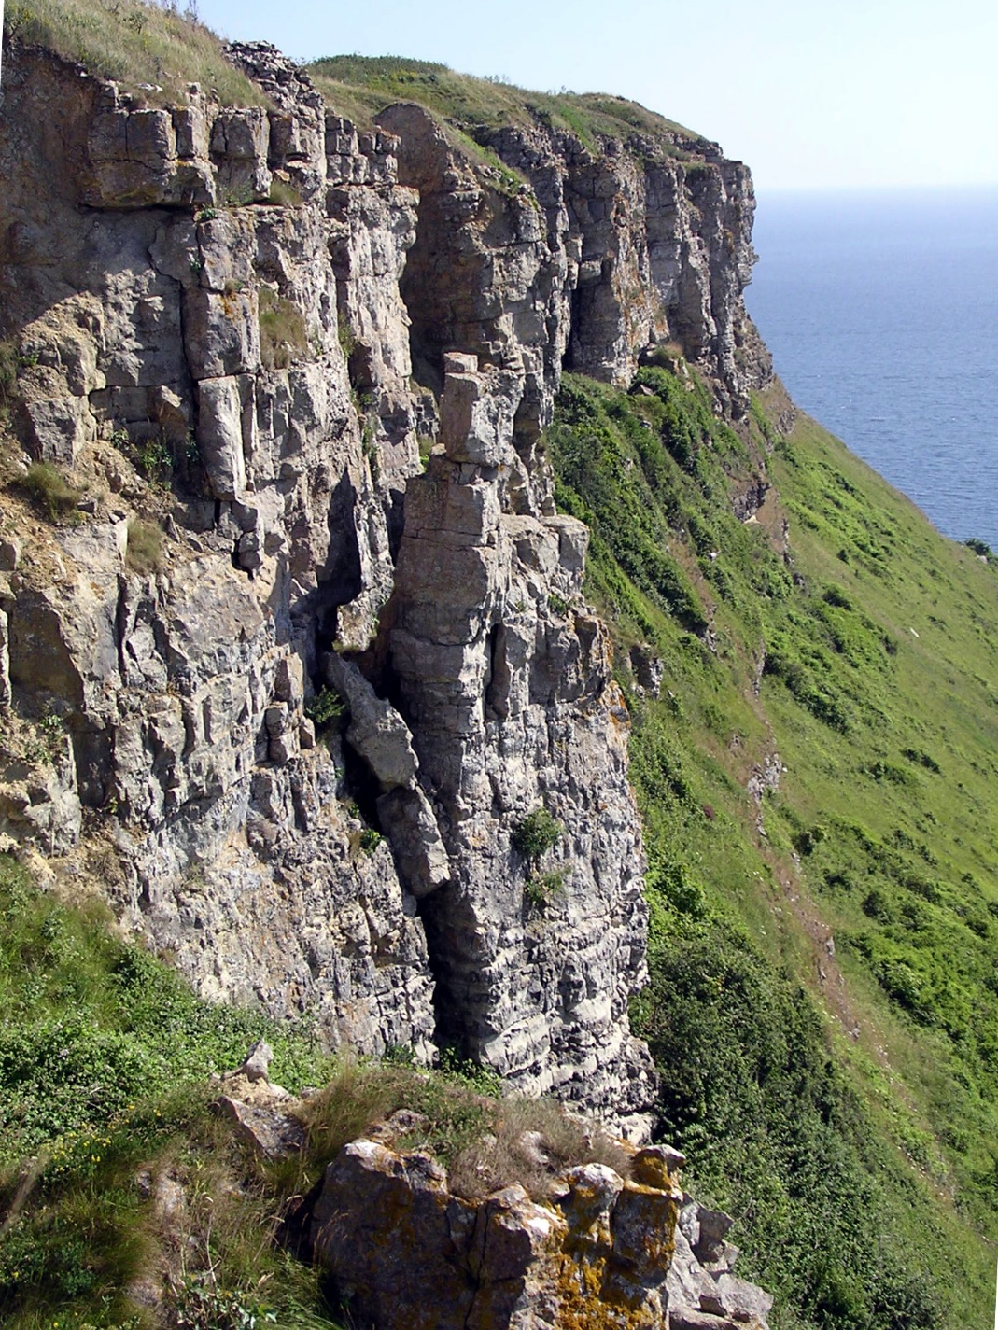
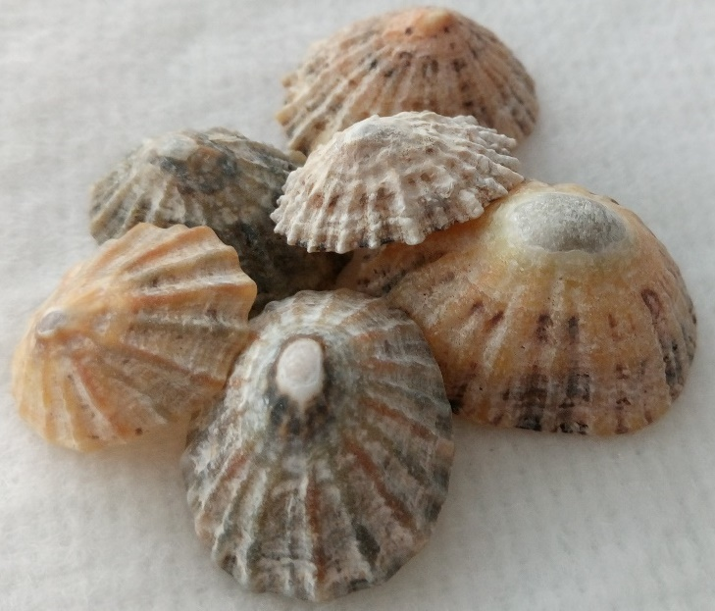

Limestone
A) Classification
B) Uses, extraction & environmental impacts
Emmets Hill cliffs, Isle of Purbeck, U.K. (2005)
Author Jim Champion
Notes:
We see limestone in many places around the world.
Eg, Dover – famous white chalk cliffs, Fossiliferous limestone escarpment in Llangollen.
Sedimentary rocks cover ~75% earths surface, of which 10% are limestones.
They are composed of materials that have a biogenic origin (eg shelly fossils) rather than an inorganic origin, and contain more than 80% calcium carbonate

Slide 2

A) Limestone classification
Optical analysis methods
Mineralogy
Components
Texture
Porosity
Rock name

Slide 3
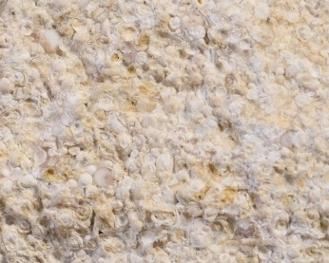
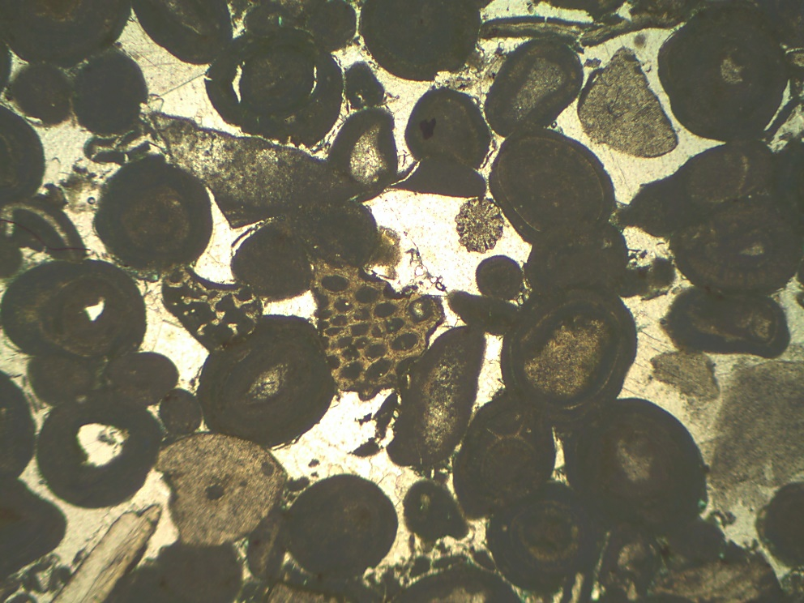
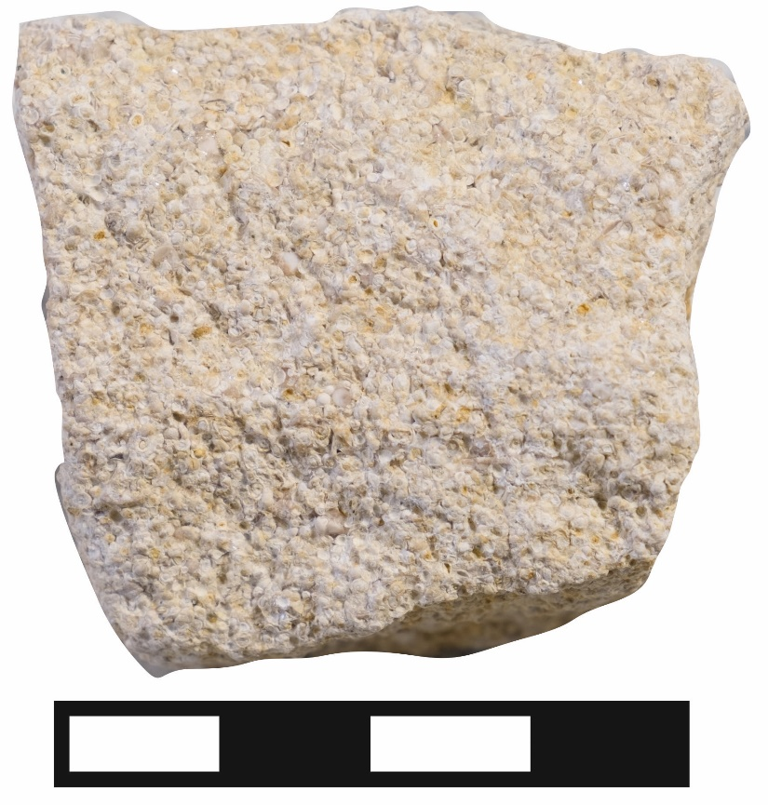
Limestone optical analysis Hand specimen and thin section microscopy Observations and interpretations
1 mm
#1074 Oolitic limestone
1 CM
Notes:
Use of Hand specimens, thin sections

Slide 4
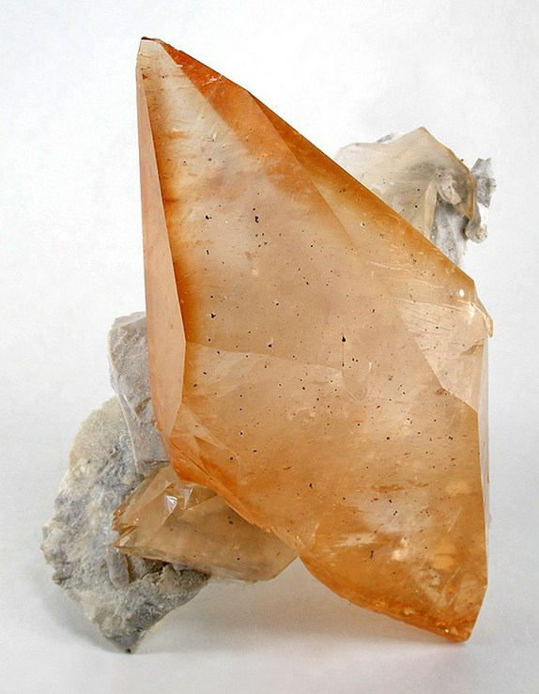
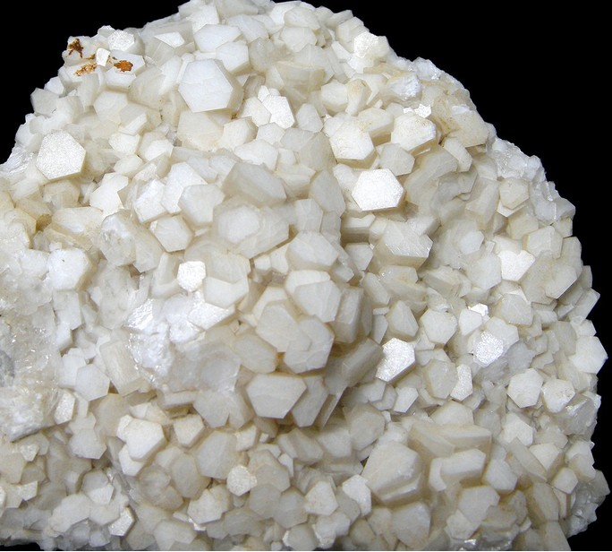
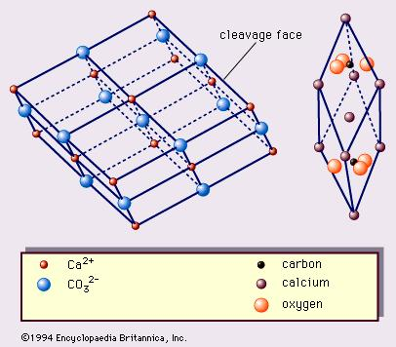
Limestones mineralogy - Calcite CaCO₃ (aragonite CaCO₃/dolomite (Ca.Mg)CO₃)
Mineral properties
System: Trigonal
Colour: White, Yellow, Red
Lustre: Vitreous, Sub-Vitreous, Resinous, Waxy, Pearly
Hardness: 3
Dog tooth spar
Elmwood mine, Carthage, Central Tennessee Ba-F-Pb-Zn District, Smith Co., Tennessee, USA
Rhombohedra
Lane Quarry, Northfield, Franklin Co., Massachusetts, USA
https://www.mindat.org/min-859.html
Notes:
Most carbonates are produced by the formation and deposition of carbonate minerals. That is by chemical and biochemical precipitation.
What is the mineralogy of the carbonates?
Limestones are primarily composed of the mineral Calcium carbonate. There are two minerals with this composition, calcite and aragonite. These are crystal polymorphs ie they have the same chemical formula but different crystal structures and so different physical and chemical properties. .
Calcite Trigonal crystal structure – stable over time
Aragonite orthorhombic crystal structure – less stable over time -= meta stable, Aragonite recrystallizes to calcite over time
Also high magnesium calcite eg echinoids have Mg in their skeletal material – Mg replaces some Ca atoms
Dolomites (dolostones) are primarily composed of the mineral dolomite. This is a calcium/magnesium carbonate.

Slide 5
Limestone components
Depositional components
Grains:
Skeletal
Non skeletal
Matrix:
Carbonate Mud – Micrite
Chalk (coccolithophores)
Post-depositional components
Calcite cement - sparite
Notes:
Limestones: formed by accumulation of primarily biogenic materials
Carbonate components
Depositional components:
Skeletal: These are biogenically produced. They are formed by processes that involved biological mediation ie by living organisms, ie shelley material from organisms such as bivalves, brachiopods and corals.
Non-skeletal: Or non-skeletal grains created by formation of calcium carbonate not associated with skeletal organisms such as Ooids and algal material.
Micrite: Mud. These are small <62um grains size calcium carbonate. Called Micrite.
Post-depositional components:
Cement: Post-depositional material – diagenesis – chemical precipitation

Slide 6
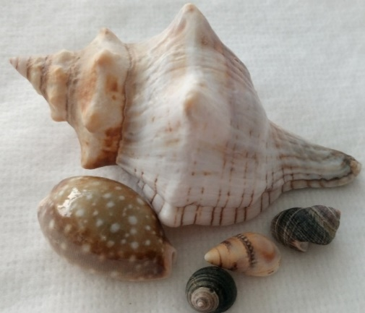
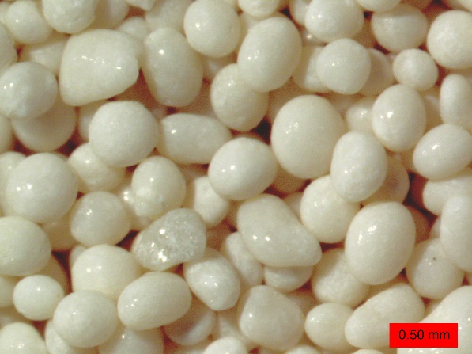
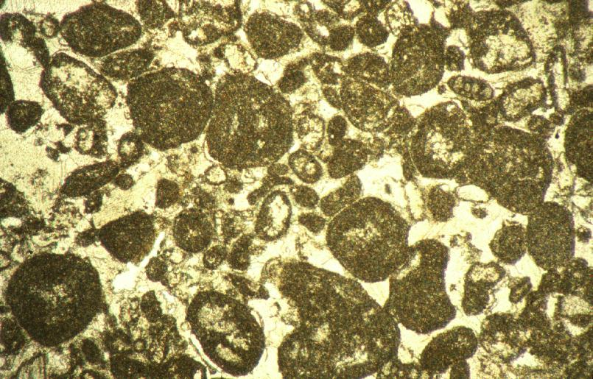
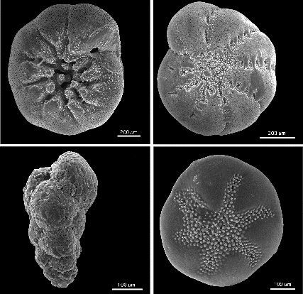
Limestone components
Skeletal and non-skeletal grains
Skeletal grains Non-skeletal grains
Macrofossils
Gastropods
Corals
Ooids
Microfossils
Foraminifera
Peloids
Notes:
Skeletal grains
Calcite (and aragonite) shells formed, calcite precipitation by biological mediation. Examples you may come across in these topics may be formed in marine, freshwater or brackish water environments at a variety of water depths:
Once the animals have died they fall apart because:
Organic material that forms part of the organism is decomposed. Eg the two halves of a cockle shell
There is physical impact and abrasion of larger grains by smaller grains
There is chemical corrosion by slightly acid water
Examples of skeletal organisms include
Bryozoa; (Encrusting/massive, branching) marine and non-marine
Gastropods; marine, non-marine, brackish
Bivalve; marine and non-marine
Brachipod; marine
Coral; marine
Echinoid; marine
Also see A3 sheet for other carbonate component examples
Identifying the type of skeletal remain, fossil, is also important in being able to infer the environment of deposition.
Non-skeletal grains
Ooids
Ooids are spheroidal grains with a nucleus, such as a grain or biogenic fragment, and a mineral cortex accreted around it.
As the mineral accretes it forms concentric growth lines and increases in sphericity with distance from the nucleus.
The term “ooid” is applied to grains less than 2 mm in diameter.
Oolite is a sedimentary rock made up of ooids (ooliths) that are cemented together.
They tend to be white but can be pink –manganese calcite
Modern environments formation: Shallow water tidal or beaches – keep rolling around to grow spherically
Maltese cross extinction pattern in thin section
Peloids
Pellet shaped, from multiple sources
Typically 0.1 – 0.5 mm dia
No concentric structure
Often form a large part of micritic mud

Slide 7
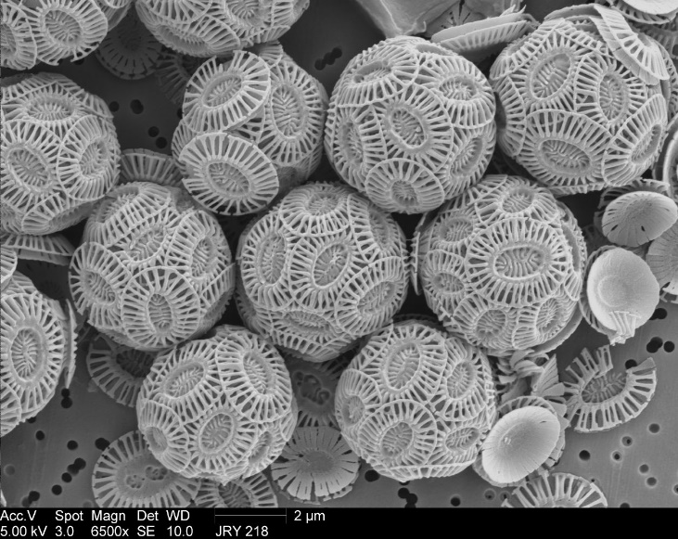
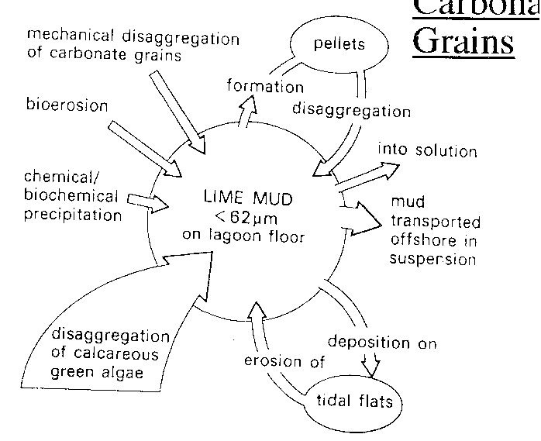
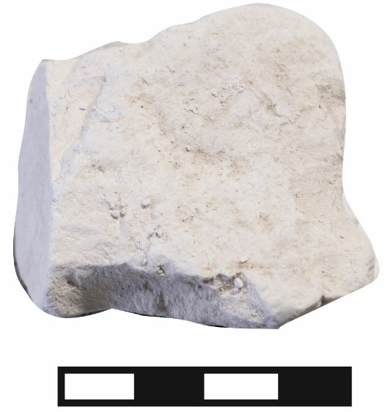
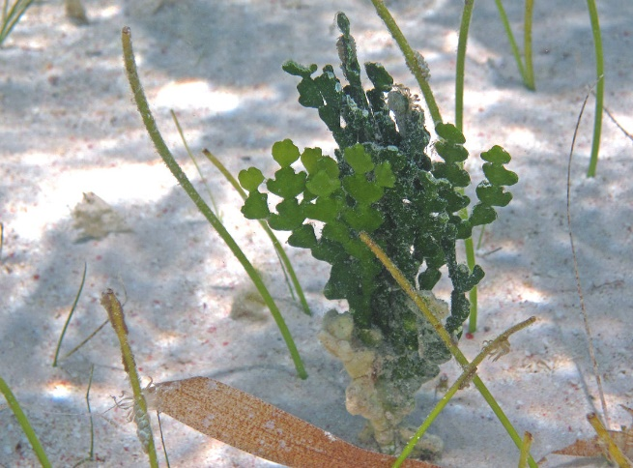
Carbonate mud – Micrite Carbonate Mud is biological in origin
Limestone components
Micrite and chalk matrix
Micrite Chalk
Chalk – deep water
R98
Halimeda incrassata (calcareous green algae) (San Salvador Island, Bahamas)
Shelly fossils
Notes:
MICRITE
Micrite is CaCO3 (sometimes referred to as lime) mud. The grain size is <62um – so it is very fine so difficult to determine origin
The mud particles form in sea water, generally by biological processes rather than direct precipitation from the sea water – although this can happen
The principle place these form is in warm (usually tropical) water which is supersaturated with CaCO3
The components of calcium carbonate are dissolved in water. When the water is has dissolved these components, to the point where any more dissolution promotes precipitation of calcite, it is called super-saturated. It is easier to develop supersaturated sea water in warm environments.
Diagram on the left: the various source of lime mud
The largest component is from the disaggregation of calcareous green algae. Image below is halimeda, a calcareous green algae, seen on the floor of a shallow tropical marine water body. When the plant dies and decomposes, these needles fall to the floor of the water body and form layers of lime mud.
As a reminder: Carbonate mud is Biological in origin
Lime is a word often used . It means calcium carbonate limestone.
CHALK
In open water there are microfossils and nannofossils of zooplankton (animals) and phytoplankton (algae) with skeletal material post death. These are present in billions of individuals and after death collect on the ocean floor.
Siliceous organisms:
Sponge spicules, diatoms, radiolarian
Calcitic organisms:
Foraminifera
Coccolithophores: are spherical cells about 5–100 micrometres across, enclosed by calcareous plates called coccoliths, which are about 2–25 micrometres across. Each cell contains two brown chloroplasts which surround the nucleus.
Chalk is primarily calcium carbonate (predominantly coccolithophores) with siliceous material (this can then form chert)

Slide 8
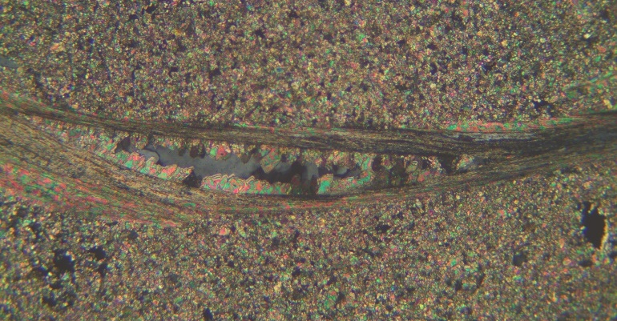
Limestone components - crystal fabrics
Post depositional processes - Diagenesis
All the physical and chemical processes that affect a sediment after it has been deposited.
Cementation/dissolution
Recrystallisation
Replacement
Compaction
Notes:
Diagenesis – the physical and chemical changes occurring during the conversion of sediment to sedimentary rock and post lithification i.e. everything that happens to a rock post deposition and before metamorphism.
Burial diagenesis up to 6km/200ºC – then metamorphic
Cementation and dissolution
Cementation: formation of cements between grains and within grains by precipitation of minerals from solution
Dissolution: dissolution of minerals from existing material
Supersaturation: Ie is a state of a solution that contains more of the dissolved material than could be dissolved by the solvent under normal circumstances. Temperature or pressure or change in volume of solvent (fluid) can increase (or decrease) the amount of mineral that is saturated in a fluid ie increase supersaturation
Mineral solubilities may be affected by temperature, pH, Eh, and the concentrations of other species in the solution (https://simple.wikipedia.org/wiki/Redox , http://www.kgs.ku.edu/Hydro/GWtutor/Plume_Busters/remediate_refs/redox_chemistry.htm) lecture 1
Except for carbonates, most minerals become more soluble at higher temperatures.
The solubility of most minerals in pure water is very low (e.g. silicates, oxides, sulfides) (few hundred ppm)
Halides, sulfates, and carbonates are generally much more soluble.
Nucleation sites: Nucleation (where minerals begin to crystallise) Where will a mineral start to grow – change of physical state. A place that is easy – the same mineral usually, or impurity. think boiling water in a kettle and bubbles on roughened surface.
Recrystallisation
Recrystallisation – change in texture
Replacement
Replacement: replacing one minerals by another – change in texture
Compaction
Chemical compaction: recrystallisation/dissolution of minerals during compaction
Physical compaction

Slide 9
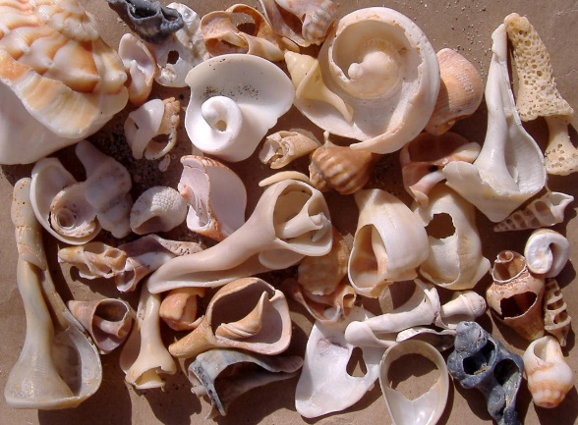
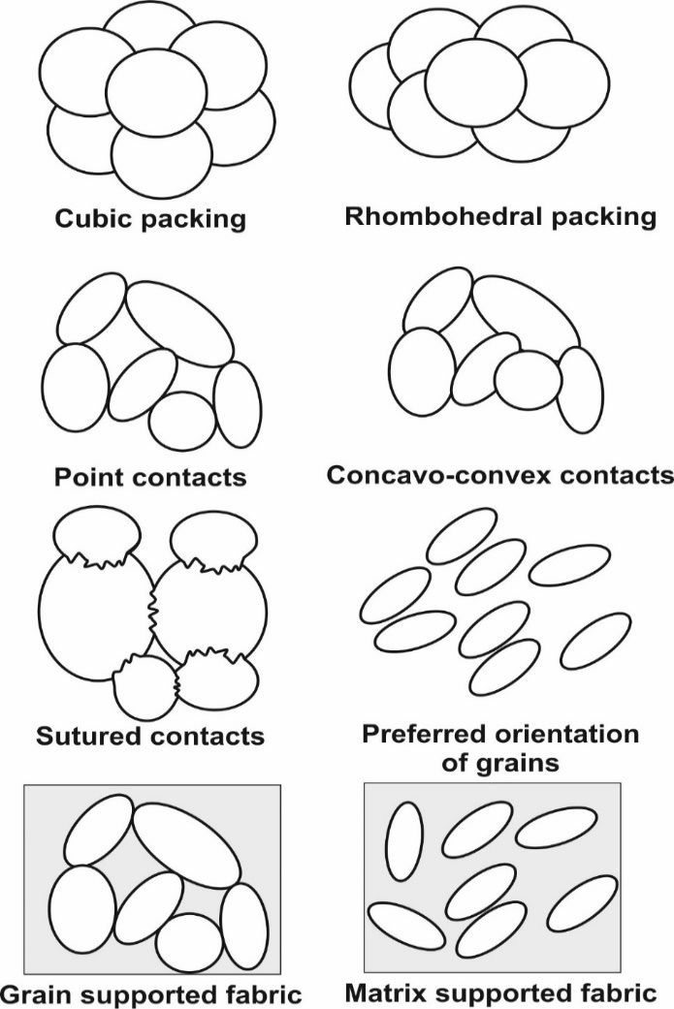
Limestone textures Physical, biological and chemical alteration and compaction
Depositional and post-depositional
Depositional
Notes:
Grain alteration
Physical, biological and chemical alteration of grains
Mechanical processes (abrasion)
Bioerosion by fish, sponges, worms, echinoids, fungi etc
Chemical erosion by water following animal death
When grains are modified we can by breakage or chemical dissolution we can classify them as:
Articulated shelly material that has more than one part is still intact (left hand image)
Disarticulated shelly material that has more than one part where the different [arts are whole but separated (left hand image)
Fragmented carbonate grains that are broken (right hand image)
Where shelly material is broken so small that it is silt sized particles then it contributes to the matrix with carbonate mud.
Fragmentation of grains can be used to interpret post-depositional processes
Compaction fabrics
Reaction of rock to overburden stress – porosity decreases systematically with depth.
Physical
Dewatering
Close packing grains - Increase in packing density and length of grain contacts
Deformation of (ductile) grains (may be accompanied by fracturing and bending)
Chemical
pressure dissolution (formation of stylolites and horsetails)

Slide 10
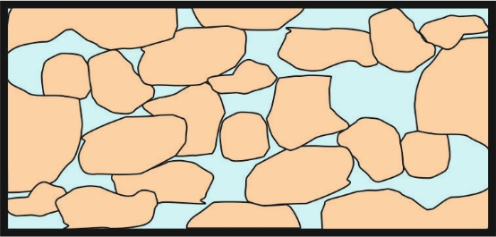
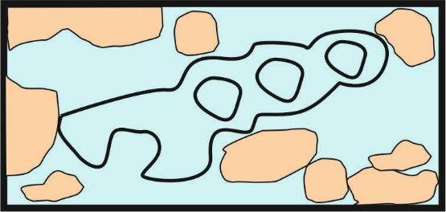
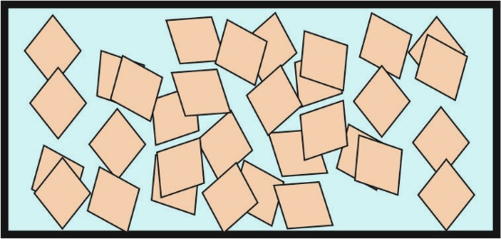

Limestone porosity
Secondary porosity Primary porosity
Interparticle porosity
Each grain is separated, giving a similar pore space arrangement as sandstone
Intraparticle porosity
Pore space is created inside the individual grains
Intercrystalline porosity
Produced by spaces between carbonate crystals
Moldic porosity
Pores created by the dissolution of shells etc.
Notes:
Primary porosity
Interparticle porosity
Each grain is separated, giving a similar pore space arrangement as sandstone
Intraparticle porosity
Pore space is created inside the individual grains eg inside a snail shell
Secondary porosity
Intercrystalline porosity
Produced by spaces between carbonate crystals
Moldic porosity
Pores created by the dissolution of shells etc.

Slide 11
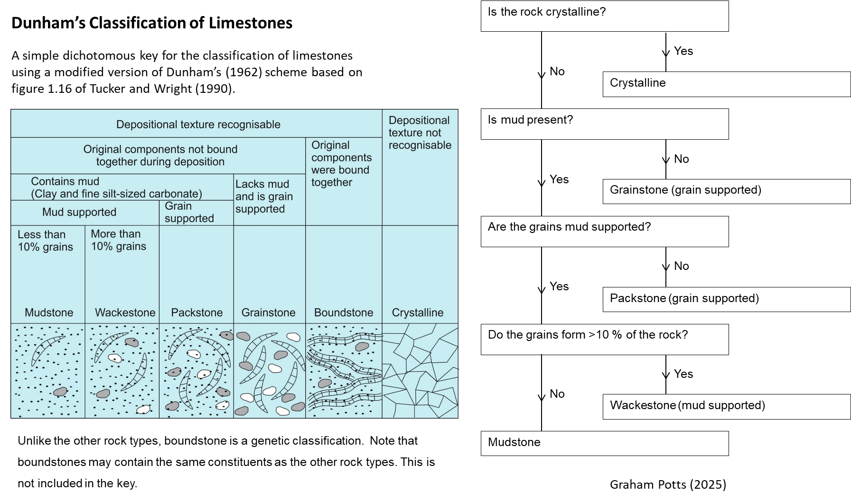
Limestone rock name
Dunham Classification for Limestones

Slide 12
Limestone classification practical

Slide 13
B) Limestone uses, extraction & environmental impacts
Limestone uses
Global market
Limestone extraction
Environmental impacts

Slide 14
Limestone uses
As whole or ground rock
Building material: Beautiful, easily worked
Iron and steel: Purify iron/steel by removing silica and creates slag
Glass: Used as a stabilizer, increases durability and controls glass viscosity
Environmental remediation: neutralization of chemical waste
Agriculture/Soil: Balancing pH
As processed material
Cement/concrete: Essential for building and infrastructure
As Storage
Oil/water industry: Useful reservoir rocks because they often have high porosity and permeability
Understanding the past
Palaeoenvironment and evolution: Depositional settings, diagenetic processes, past life
Notes:
Construction & Building:
Building Stone:
Limestone is a durable and aesthetically pleasing material used for walls, decorative trim, and veneer.
Cement & Concrete:
Limestone is a key ingredient in cement, which is essential for concrete used in roads, foundations, and structural elements.
Road Building:
Crushed limestone is used as aggregate for the base of roads.
Fireplace Surrounds:
Limestone is a popular material for fireplace surrounds due to its durability and natural beauty.
Accent Walls:
Limestone can be used to create accent walls in kitchens, bathrooms, and other rooms.
Kitchen Countertops:
Limestone is suitable for kitchen countertops due to its durability and heat resistance.
Wall Cladding:
Limestone wall cladding is a common material for accent walls, fireplaces, and other building elements.
Agriculture:
Soil Conditioner:
Limestone is used to neutralize acidic soil, improving conditions for plant growth.
Agricultural Lime:
Ground limestone is used as agricultural lime to improve soil quality and increase crop yields.
Feed Supplement:
Limestone is added to animal feed to provide calcium for strong bones and eggs.
Industries:
Steel Production: Limestone is used to remove impurities from molten iron in steelmaking.
Glassmaking: Limestone is used in the production of glass.
Paper Production: Limestone is used as a filler in paper making.
Environmental Remediation: Limestone can be used to treat acid mine drainage and other forms of pollution.
Water Treatment: Limestone is used in water treatment to neutralize acidity and remove impurities.
Plastic Production: Limestone is used as a filler in plastic production.
Other Uses:
Toothpaste: Limestone is used as a pigment and filler in toothpaste.
Textile Industry: Limestone is used as a filler in the textile industry.
Pharmaceuticals: Limestone is used in the production of some medications.
Cosmetic Products: Limestone is used in some cosmetic products.
Sculptures and Monuments: Limestone is a durable and aesthetically pleasing material used for sculptures and monuments.
Decorative Features: Limestone is used for decorative features like fireplaces, staircases, and window casements.
Fillers: Limestone is used as a filler in a variety of industries, including paint, rubber, and glass.

Slide 15
Limestone uses – global and UK market
The global Limestone market size is projected to grow to USD 106.36 Billion by 2029
Production and consumption of limestone is led by North America, Europe, and Asia-Pacific, especially China and India.
The increasing demand is driven by water purification, steel manufacturing, soil conditioning, aggregates and cement/concrete because of rapid industrialization, infrastructure development, and urbanization.
All uses have complex environmental impacts including release of CO₂, transport, additional chemicals used in industrial processes with waste product disposal challenges.
Extraction of limestone:
All councils in the UK are required to work with their associated Mineral Planning Authority (MPA) to produce a Local Plan for exploitation of minerals in the area, whilst working with other UK MPAs (see examples in documents).
Minerals in this case is used to describe geological resources.
Notes:
UK council and government information
https://www.gov.uk/guidance/minerals#:~:text=The%20mineral%20planning%20authority%20is,any%20other%20permits%20and%20approvals.
https://www.bgs.ac.uk/mineralsuk/planning/onshore-maps/
General online data
https://www.cognitivemarketresearch.com/limestone-market-report
https://uk.finance.yahoo.com/news/limestone-industry-analysis-forecast-2025-124100010.html

Slide 16
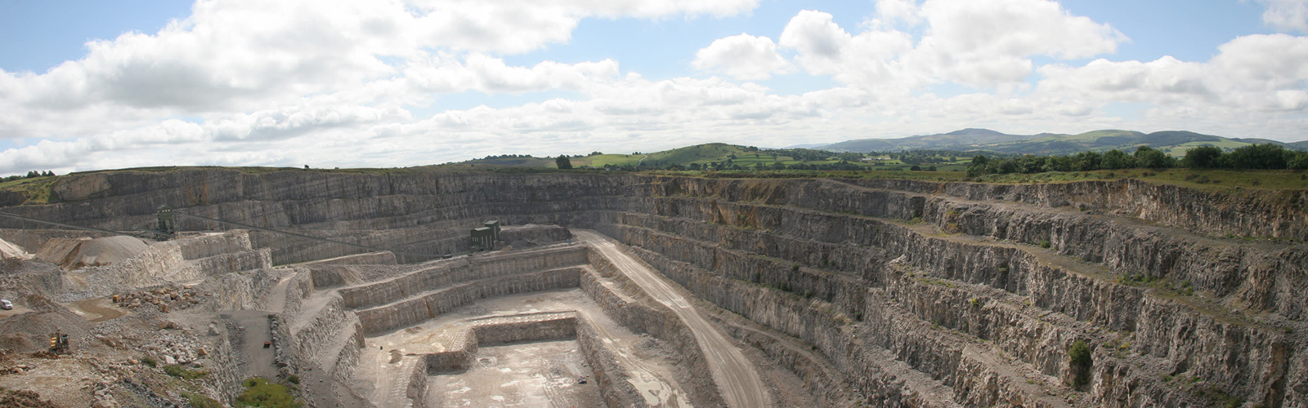
Extraction of limestone
Case study Halkyn Mountain (North Wales)
Extraction Method:
Open-pit Quarrying: The most common method, involving removing soil and vegetation to access underlying limestone deposits. Open-pit quarrying often uses bench formation, creating terraces within the quarry to facilitate extraction.
https://www.halkynmountain.co.uk/limestone/
Notes:
Limestone is primarily extracted from quarries, both surface and underground. It's often found in areas with shallow marine environments or where limestone deposits are thick and extensive. Significant limestone deposits are found in various regions around the world, including:
In the UK:
Carboniferous Limestone: Extensively found in the Peak District, Pennines, South Wales, the Mendips, and the Midland Valley of Scotland.
Cretaceous Chalk: A significant source of limestone in eastern and southern England.
Other areas: The East Midlands, North East Wales, the Bristol Channel area (Mendips, Bristol, Bath), and parts of southern England (east Kent).
Internationally:
China, the US, Russia, Japan, India, Brazil, Germany, Mexico, and Italy: These are some of the world's largest limestone-producing countries.
Michigan (USA): Known for some of the world's biggest quarries, particularly near the Great Lakes coastlines.
Portugal: Areas like Serra D´Aire e Candeeiros, Ataija, Pero Pinheiro, Lourinha, and Fatima are significant extraction areas.
Australia: Coffin Bay is a location with a large deposit of limesand.
Other locations: Limestone is also found in the Caribbean, around the Indonesian islands, and in the Central Highlands of Scotland, including areas like Loch Tay and Blair Atholl.
Extraction Methods:
Surface Quarrying: This is the most common method, involving blasting, excavating, and hauling rocks to processing facilities.
Underground Mining: Used in certain areas and can be advantageous in some situations, especially near cities.
Blasting: A key part of quarrying, using explosives to dislodge rocks.
Cutting: to produce slabs for building facing etc
Surface Limestone Mining (most common):
The basic elements of surface mining are overburden removal, drilling, blasting and hauling ore to the crushing and processing plant. The selection of surface mining equipment varies with the particular requirements at each operation, including production capacity required, size and shape of the deposit, haul distances, estimated life of the operation, location relative to urban centres, and other social and economic factors. Other factors that must be considered in surface mining are the value of the products produced, location of competitive operations, and environmental and safety requirements associated with a particular deposit.
Underground Limestone Mining :
The basic operations in underground mining are drilling, blasting, loading and hauling, scaling and roof bolting. Drilling equipment includes horizontal drills and down hole track drills. This equipment is generally quite different from that used for surface mining and results in much smaller blast holes and a lower volume of rock produced with each blast. Other equipment required in the underground mine includes powder loaders, which are used to blow ammonium nitrate–fuel oil mixtures into the blast holes. Scaling rigs, which are used to remove loose rocks from the ribs and roof of the mine, and roof-bolting equipment may also be required in an underground mine.
Other resources
Limestone Mining Process Explained
Images to show the various steps in limestone mining for blocks
https://makingvictoriandublin.com/portfolio/quarry-and-marble-works-visit/
Good description of how a quarry works:
How different layers of limestone are used for different purposes: Steel industry, road building and agriculture.
A section about other rock types quarrying for high quality road stone and asphalt.
More detail about crushing, sieving and sorting.
Dust safety.
Transport.
https://www.youtube.com/watch?v=sWgaLikMPfc

Slide 17
Environmental impacts of limestone extraction
Environmental impact assessment
A systematic process to identify the environmental significance of a building or industrial project – in this case limestone extraction.
The data collected should describe:
Impact:
The direct and indirect effects of the proposed plans
Magnitude of effects and cumulative impact
Significance of impacts
Spatial and temporal scope:
The impacts on local and regional scales
The timescales of effects on short, medium and long term
Rehabilitation plan

Slide 18
Environmental impacts Assessment practical

