Slide 1

Environmental impact assessment of limestone extraction
Case study:
Wigly Quarry
Notes:
This presentation outlines how to approach developing an Environmental Impact Assessment for the re-opening of a limestone quarry.

Slide 2
Background to limestone extraction at Wigly Quarry
Wigly Quarry is a dormant limestone quarry. The site is ~75 Ha, elevation ~150m. The quarry was commissioned in 1957 and produced crushed rock. However, it has not been in use since 1980.
The cessation in its use was because:
The economic climate favoured limestone imports.
Significant local building ceased due to greenbelt designation of large areas of local land surrounding nearby urban and suburban areas.
Restrictions to redesignation of farmland for building, due to European and UK Government funding to expand environmentally sensitive farming initiatives.

Slide 3
Supporting information for the proposed
new operation of Wigly Quarry
Recent scoping surveys have indicated ~150 million tonnes of additional reserves. Re-opening of the quarry is proposed to extract ~ 2 million tonnes per year until limestone exhaustion.
The limestone, for crushed rock, would be extracted through drilling and blasting. Material would be processed on site.
The current economic climate favours limestone quarrying in the UK, rather than increasing imports. Crushed limestone is required for local users:
The development of a new industrial park.
Significant local home building is required for the new jobs. This has been approved following redesignation of some greenbelt to expand two local towns, Cowling and Horsebridge.
It is most economical to transport crushed limestone less than 50 miles to point of use. To support this application the quarry owners note that there are access points to the quarry linking to:
The A road network: A1601 (N-S) and A1702 (E-W) main roads.
The new Eastern Rail link provides distribution infrastructure only 0.25 miles from the quarry. This runs N-S through Horsebridge (opened in 2005).
Notes:
Limestone density varies between ~2.3g/cc and 2.7g/cc the limestone at Wigly is generally low magnesium with density 2.5 g/cc
The seam is approximately 100m deep and 75 hectares in area
1: volume of limestone cubic metres: 1 hectare is 10,000 square metres, 75 hectares is 750,000 square metres, volume of seam is 750,000 x 100 = 60,000,000 cubic metres
2: Volume limestone cubic centimetres: 60,000,000 cubic metres x 1,000,000 = 60,000,000,000,000 cubic centimetres
3: Limestone grams: 60,000,000,000,000 x 2.5 (g/cc) = 150,000,000,000,000 gram
4: Limestone tonnes: 150,000,000,000,000 / 1,000,000,000 = 150,000,000 tonnes

Slide 4
Permissions for re-opening of Wigly Quarry
Planning permission is being sought for:
Re-opening of the quarry.
Extending and deepening the quarry profile.
Upgrade and extension of the office, car park and ancillary buildings.
Planning Permission is required to ensure:
Facilitating the sustainable use of minerals.
Conserving or enhancing the natural environment.
Promoting sustainable transport.
Meeting the challenge of climate change and flooding.
Supporting a prosperous local economy.
An environmental impact assessment must be developed prior to PP approval

Slide 5
Your task is to develop an Environmental Impact Assessment (EIA)
An EIA is a systematic process used to identify the environmental significance of a building or industrial project.
The data collected should describe:
Impact:
The direct and indirect effects of the proposed plans
Magnitude of effects and cumulative impact
Significance of impacts
Spatial and temporal scope:
The impacts on local and regional scales
The timescales of effects on short, medium and long term
Rehabilitation plan
In order to develop an EIA you should take into account the quarry surroundings that will affect, or be affected by, quarrying. You have a map of the area identifying areas of significance within a 5km buffer zone around the quarry and a series of surveys identify the potential impacts of quarrying.

Slide 6
Data for the EIA:
Map of Wigly Quarry and surroundings
Quarry - red line identifying full extent of quarry site.
Quarry – red dotted line identifying proposed quarry size within the quarry site.
Locations within quarry site of proposed infrastructure:
Offices
Crushing and screening equipment
Ancillary buildings such as blasting materials storage, large plant and vehicle storage etc
Black dotted 5km buffer zone around the quarry within which existing or proposed sites of interest:
Major roads and rail links for transport of quarried materials.
Major towns, villages and housing estates
Proposed industrial park
Large forested areas
Farmland
Rivers, reservoir and small water courses with contour lines to define water sheds and expected run-off
Viewpoints
Notes:
Access points to quarry:
A1601 (N-S) and A1702 (E-W) main roads
Eastern Rail link
Important quarry surroundings:
Horsebridge and Cowling towns
Ducklings, Pigly and Henling Magna villages
Peter estate
Lis Farm and Maggie Hall Farm
Cowling Forest
Bear Brook
Henling Lake Reservoir
Viewpoints determined from contour lines

Slide 7
Data for the EIA:
Potential impact surveys created by experts
Ecology and biodiversity
Protected land animal surveys and habitat quality
Protected plant surveys and habitat quality
Protected water animal surveys and habitat quality
Air and Water
Air quality and human health
Impacts on local drinking and irrigation water
Human Environment
Light and noise pollution
Employment opportunities
Community value creation
Notes:
This and the next slides provide background and concepts essential for developing an EIA. This set of data can be used to complete the EIA form given on later slides.

Slide 8
Ecology and Biodiversity Summary
Protected land animal surveys and habitat quality - Bats
Quarrying activities can significantly impact bat populations through habitat loss, disturbance by activities and noise, and changes in prey availability. While quarries can also offer valuable foraging and roosting opportunities, particularly on quarry benches, the potential for disturbance, dust and habitat fragmentation requires careful consideration.
The Cowling forest and surrounding farmland has evidence of three types of bat: Pipistrelle, Brown Long-eared, Bechstein and Noctule bats. All bats are protected species and Bechstein bat is nationally important. There is no evidence of bat colonies within the quarry workings, but they do use the area for hunting.
Protected plant surveys and habitat quality - orchids
Quarries and spoil tips often provide a unique habitat that is rich in minerals and nutrients suitable for orchids. Dust, noise and other disturbances are unlikely to cause damage provided the quarrying activities do not take place on the greenbelt hillsides.
Greenbelt hillsides adjacent to the quarry site, outside the quarry site, have nationally important Lady Orchids thriving on the limestone soil.
Protected water animal surveys and habitat quality – water voles
Clean water, stable water levels, and dense vegetation on the riverbanks is essential for the success of water vole. Quarrying activities can potentially release significant dust and fine-grained material into water courses creating cloudy water. Changes to the stability of the river level can be impacted by alterations in the water table caused by quarrying. Water vole can withstand episodic poor water conditions, but prolonged changes would significantly affect their success.
Water vole are found in the upland chalk river Bear Brook which runs outside the quarry site but within the 5km buffer zone around the quarry. Water vole are an endangered species. They have suffered a population loss of 94% over the last 100 years due to habitat loss, water pollution and predation.

Slide 9
Air and Water Summary
Air quality and human health
Quarrying operations generate significant dust, particularly during blasting, excavation, crushing and loading/transportation. Limestone is a relatively low dust emission rock to process but still produces airborne material.
Quarry dust can lead to respiratory problems like silicosis (a chronic lung disease), bronchitis, asthma, cardiovascular disease and cancer. Quarry workers are protected by appropriate Personal Protective Equipment, but dust will be transported by air movement, so impacts outside the quarry must be considered.
Amounts of dust produced depend on the blasting conditions and heterogeneity in the rock. Approximate dust produced:
Dust particulate size | Transport distance during average wind conditions 10km/hour
Nuisance dust - Visible dust, over 10 microns. Remains suspended for up to 30 mins. | Few hundred meters
PM10 (<10 microns), particulate matter. Remains suspended for up to 1.5 hours. | Up to 1 km
PM2.5 (<2.5 microns) fine particle fraction. Remains suspended for several hours. | Up to tens of km

Slide 10
Air and Water Summary
Impacts on local drinking and irrigation water
Quarry operations can generate dust that can contaminate reservoirs and rivers. It can also contaminate runoff that contains solids, chemicals, and other pollutants, such as heavy metals, that can contaminate nearby surface and groundwater sources:
Changes in pH with limestone dust can increase pH:
Bear Brook has a Ph 7.4 – 8. This is high because the bedrock is limestone. Limestone dust addition is unlikely to make a significant difference to the pH
Total suspended solids from dust:
Water courses becoming more turbid. This may reduce the biodiversity such as water vole or their plant food sources. This would be episodic related to dust release events.
Disruption of groundwater flow patterns releasing chemicals such as metallic vein minerals:
A long-term change could cause an increase in metals as the vein minerals are gradually dissolved. The extent of the toxicity would depend on the metallic vein mineral. The mineral galena, PbS, can be associated with limestone. Lead is very poorly soluble but over time can contaminate a water course. There is no safe level of lead in water for humans or animals.
To minimize water pollution from limestone quarrying, implement robust water management systems, including runoff collection and treatment, and employ sustainable quarrying practices like efficient blasting and water recycling. Furthermore, control silt and sediment discharge through methods like settling ponds and vegetation cover, and conduct regular monitoring of water quality.

Slide 11
Human Environment Summary
Light and noise pollution
Light pollution: Artificial lighting used for quarry operations, including floodlights and security lighting, can contribute to light pollution over several km. It disrupts nocturnal wildlife, impacting foraging, navigation, and roosting patterns. It can also affect human sleep patterns and quality of life.
Noise Pollution: Quarrying activities such as blasting, drilling, crushing, and the operation of heavy machinery generate significant noise up to a km away. It can cause hearing damage to workers and residents, disrupt sleep, and negatively impact the behaviour of wildlife.
Quarrying, crushing and sorting is proposed to take place at least 12 hours per day, 7 days per week.
Lighting will be required as:
Quarry buildings and office lights.
Quarry site floodlighting for use in low light, especially winter working.
Transport of materials too and from the site.
Noise levels:
Drilling and blast preparation and blasting over two days per week.
Operation of crushing and sorting machinery throughout most quarry operation hours.
Transport of materials too and from the site.
Potential mitigation - lighting: Reducing the amount of lighting used, using shielded fixtures to direct light downwards, and implementing time restrictions on lighting can help.
Potential mitigation - noise: Using quieter machinery, implementing noise barriers and enclosures, and scheduling operations to minimize disturbance during sensitive times can help.

Slide 12
Human Environment Summary
Employment opportunities
Quarries offer a variety of employment opportunities, including roles in quarry operations, engineering, and management. Some common positions include quarry operative, quarry manager, plant operator, mechanical fitter, and various engineering roles. There are also opportunities in related fields like construction, mining, and even specialized areas like explosives work and health & safety.
Community value creation
Quarries, despite their initial environmental impact, can be transformed into valuable community assets through strategic restoration and land management practices. This includes creating recreational spaces, enhancing biodiversity, and fostering community engagement. Restored quarries can boost local economies, improve quality of life, and provide educational opportunities.

Slide 13
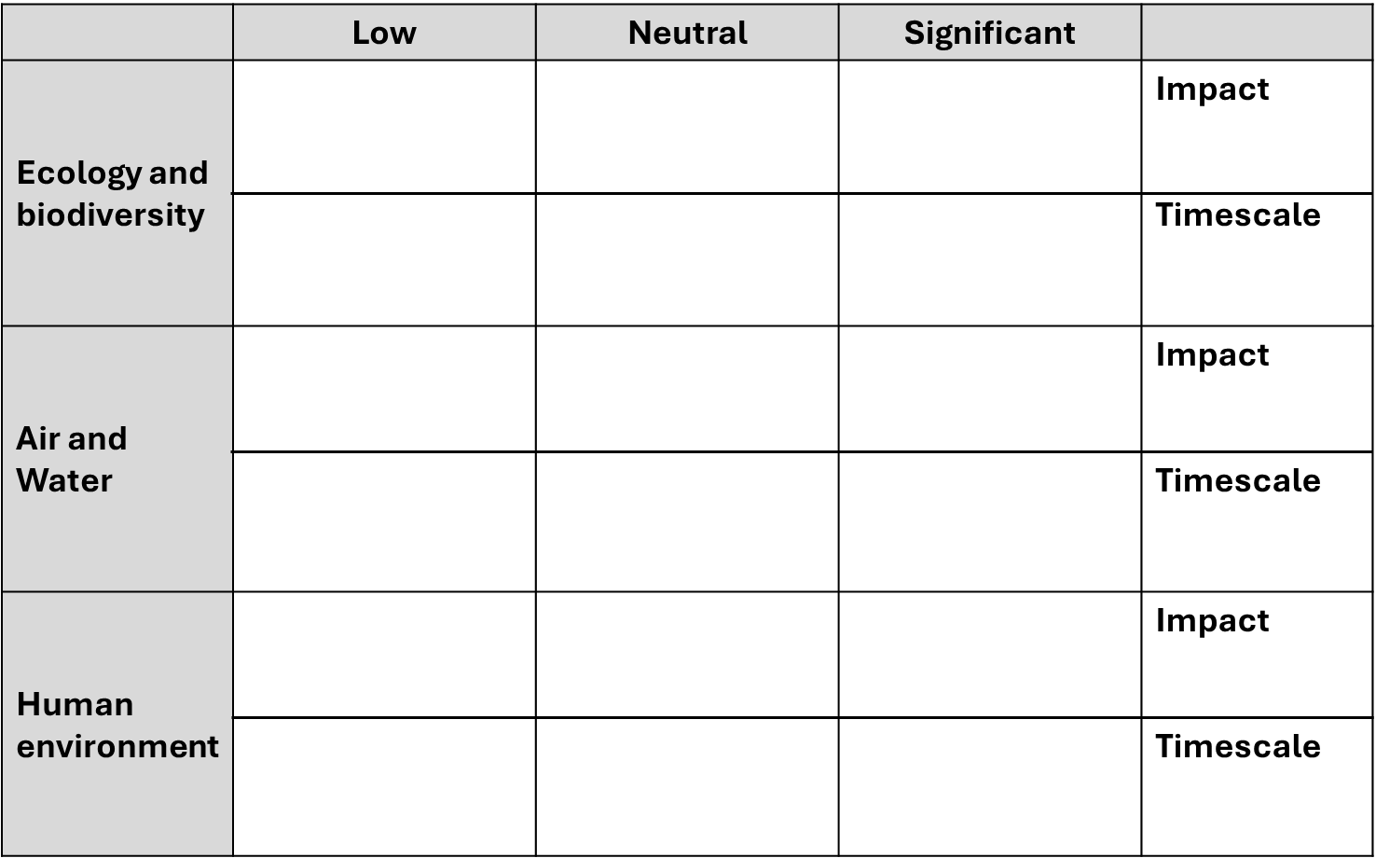
Environmental Impact Assessment - Limestone quarry
Step 1: Summarise Baseline data
Notes:
Using the information on the previous slides and the map of Wigly Quarry, complete this form

Slide 14
Environmental Impact Assessment - Limestone quarry
Step 2: Evaluate impact and plan mitigation
Impact: The direct and indirect effects of the proposed plans. Magnitude of effects and cumulative impact Significance of impacts
Spatial and temporal scope: The impacts on local and regional scales The timescales of effects on short, medium and long term
Rehabilitation plan
Notes:
Using the completed form on the previous page interpret and evaluate the data and summarise the essential impacts of the proposed quarry, suggesting mitigation as necessary.
For support, use the suggested answers given on the accompanying presentation.

