Slide 1

Analysis of sand using microscopy
Dr Lis Rushworth
Dr Maggie Williams
Mr Peter Williams
Notes:
Welcome - have handouts
The aims of this session are to outline:
The importance of sand as a construction material
The need to control the environmental impacts of aggregate extraction
To look at the sustainability issues associated with extracting aggregates
To provide physical resources for schools/colleges to help students identify grain types, shapes etc.
Electronic copies of the resources that we provide will be made available on GeoHubLiverpool after the conference.

Slide 2
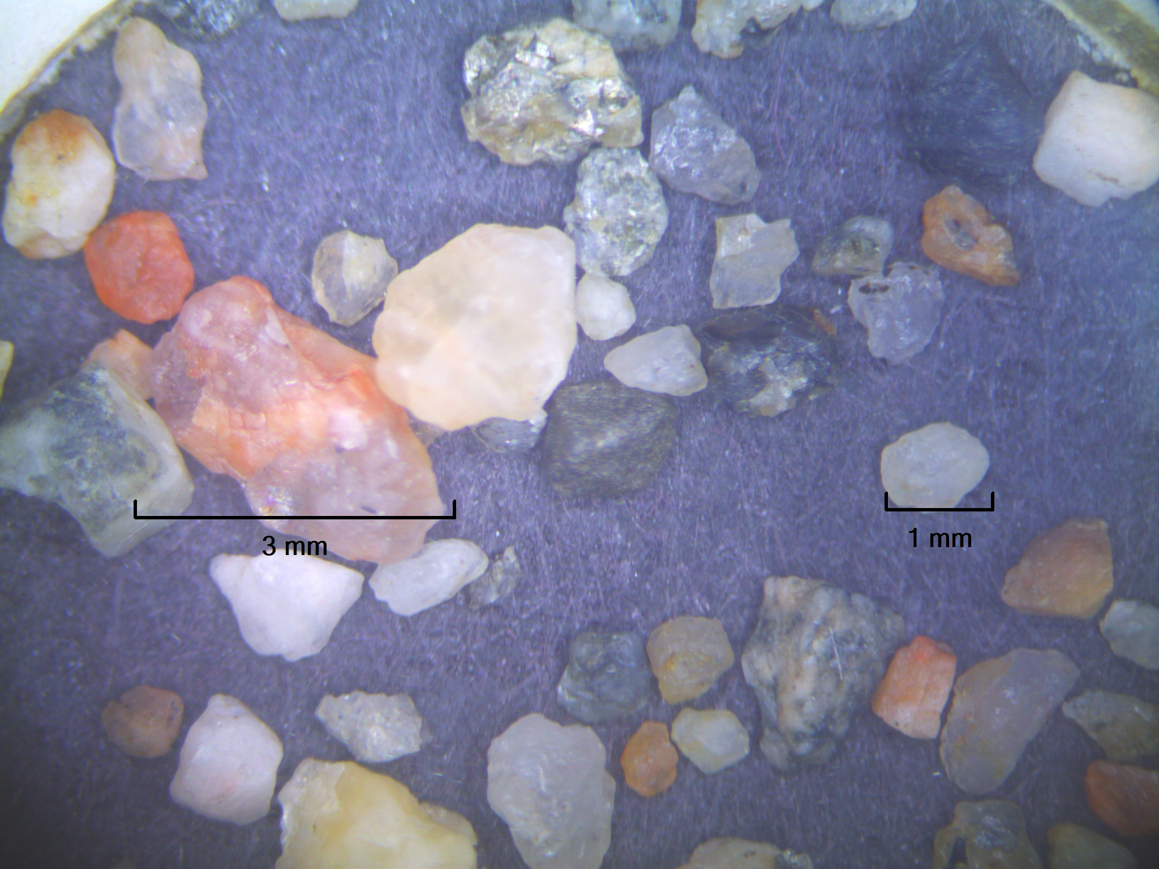
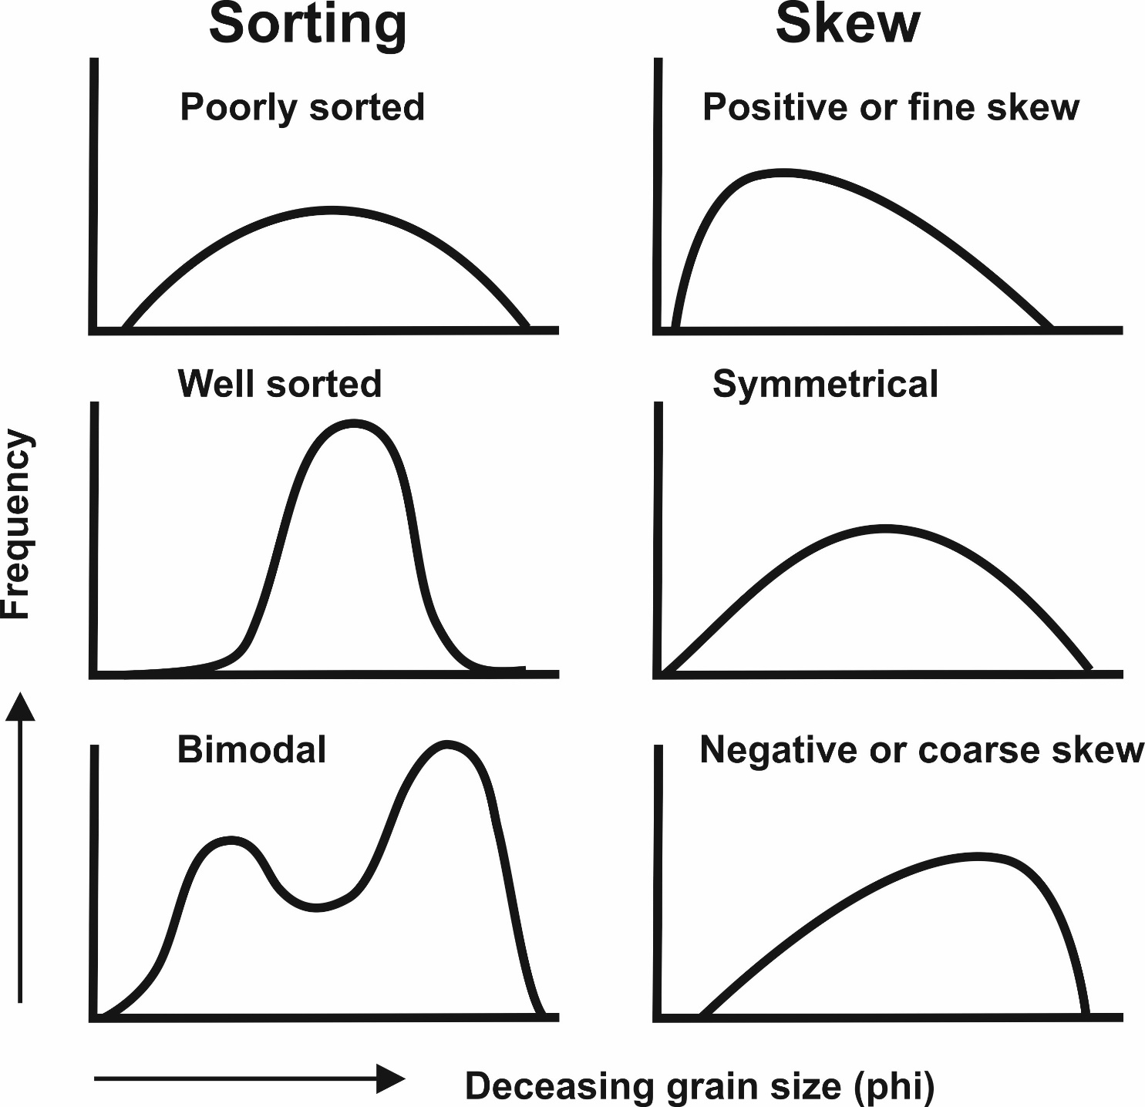
Identification of grain size

Slide 3
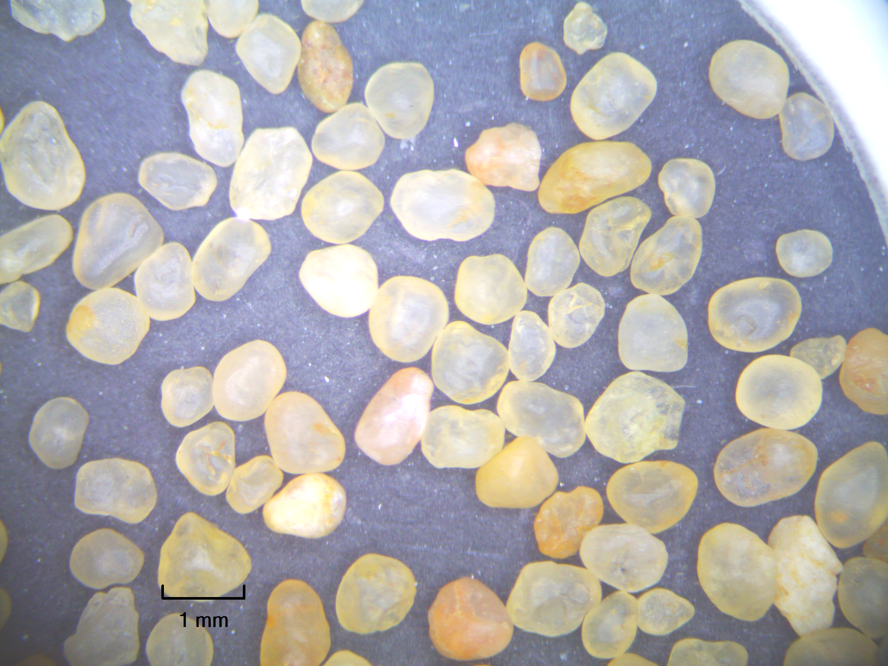
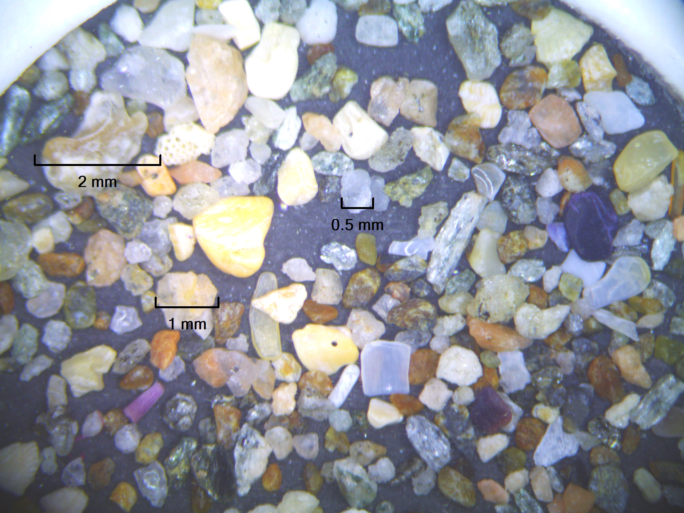
Identification of minerals in sands (colour/lustre/transparency)
River sand
Quartz
Feldspar (White/opaque)
K-Feldspar (pink/opaque)
Lithics/minerals
Bioclasts
Desert sand
Quartz
Feldspar (White/opaque)
K-Feldspar (pink/opaque)
Lithics/minerals
Bioclasts
Beach sand
Quartz
Feldspar (White/opaque)
K-Feldspar (pink/opaque)
Lithics/minerals
Bioclasts

Slide 4
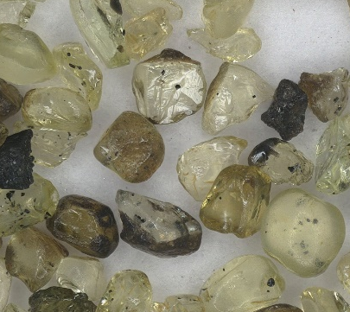
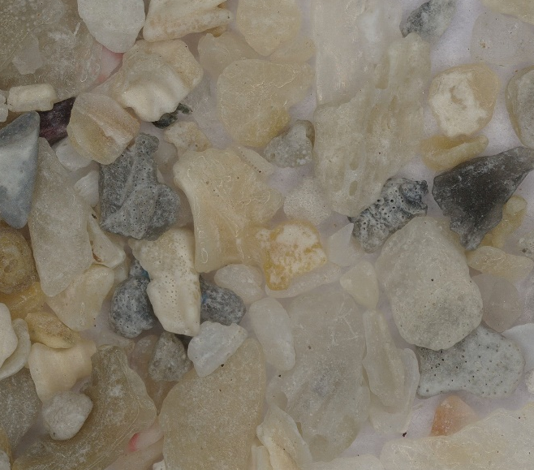
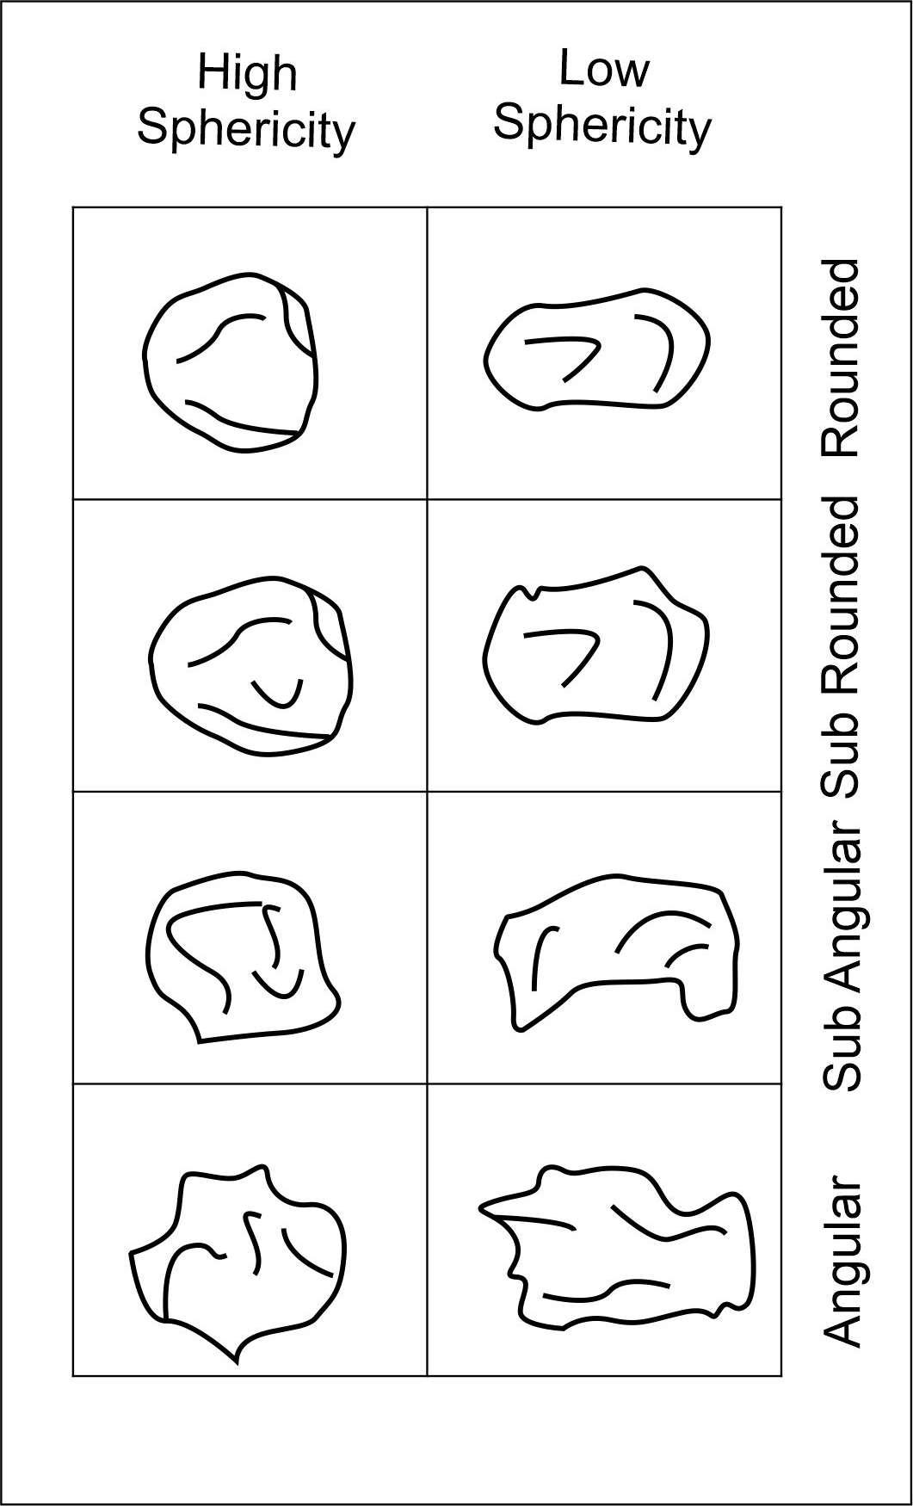
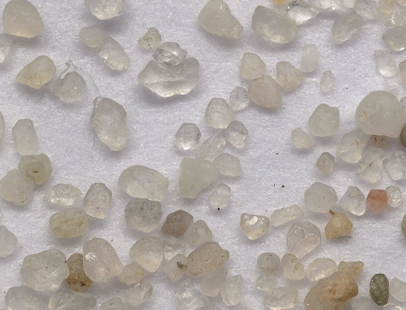
Identification of other characteristics (Grain shape/surface texture)

Slide 5
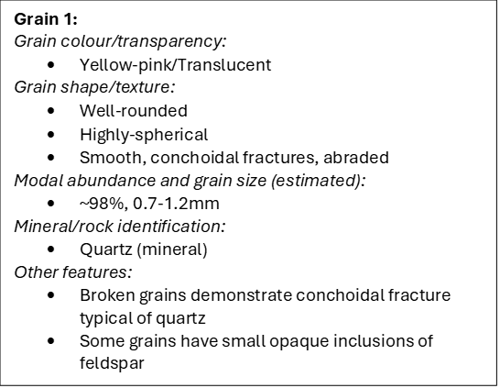
Observations from grain mounts
Grain mount
Field of View 5 mm
Notes:
Use pencil, colours,
It is a systematic drawing that capture:
Scale drawing
Outlines of grains
Should be fully able to describe the sample and answer the questions from the drawing.

Slide 7
Interpretation of sand using microscopy

