Slide 1
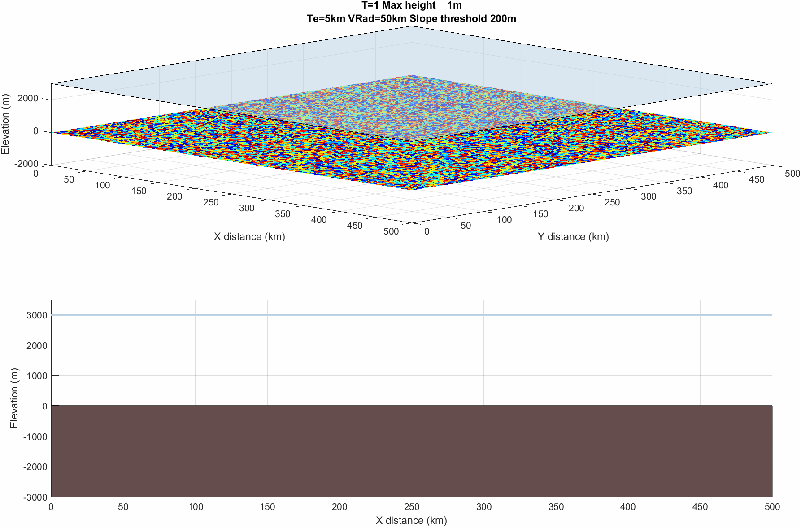
Model Parameter
Lithosphere elastic thickness | 5km
Maximum slope threshold | 200m

Slide 2

Model Parameter
Lithosphere elastic thickness | 5km
Maximum slope threshold | 100m

Slide 3

Model Parameter
Lithosphere elastic thickness | 25km
Maximum slope threshold | 200m

Slide 4

Model Parameter
Lithosphere elastic thickness | 25km
Maximum slope threshold | 100m

Slide 5
The Te=25km and maximum slope threshold 200m is the only volcano example that breaches the surface
But the Te=5km slope threshold 200m almost does!
Low slope threshold is more likely to prevent volcanic islands forming than young, hot low rigidity oceanic lithosphere

