Slide 1
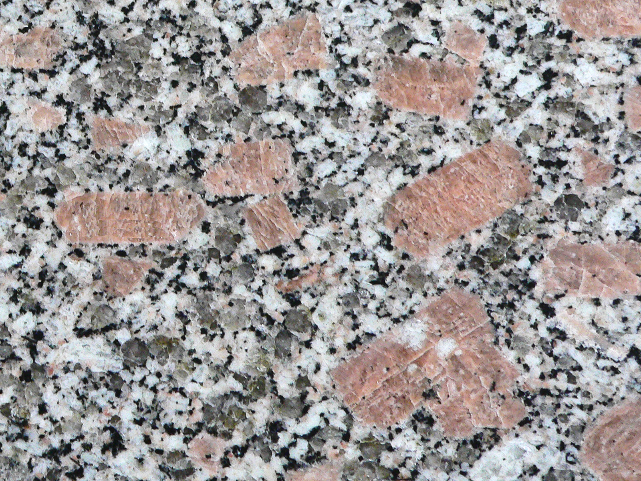
How old is this rock?
Peter Williams

Slide 2
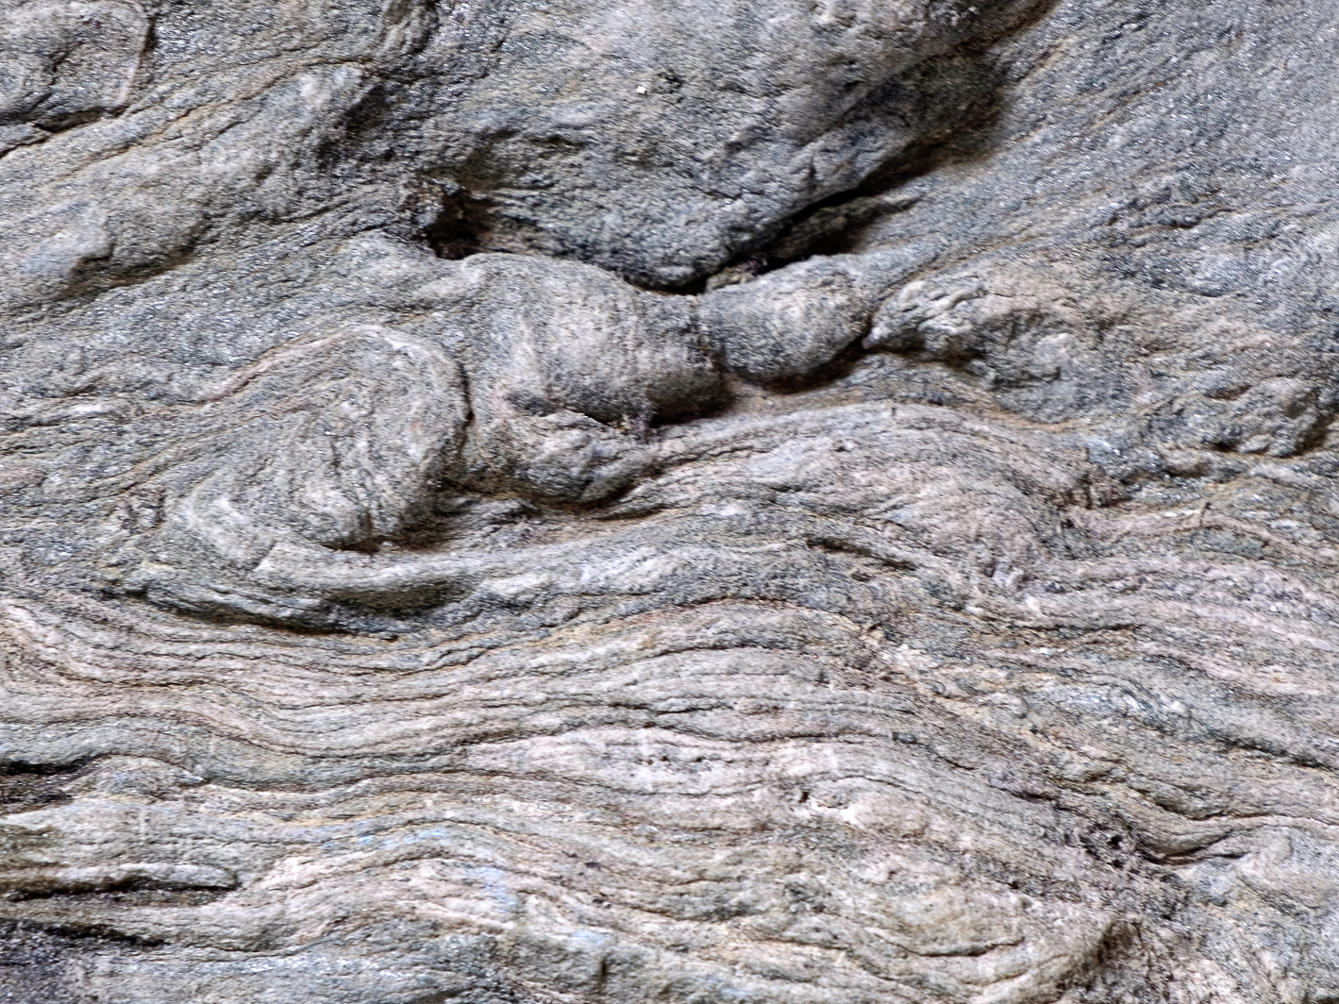
What is meant by “how old”
Notes:
Only igneous rocks used radiometric dating. Metamorphic rocks can have many ages (of components and of metamorphic events)

Slide 3
Radiometric dating
The rock must have some radioactive atoms in it
The isotope must decay slowly
Ideally the child product should be stable
Notes:
Stability makes the calculations easier

Slide 4
Decay Law
The rate of change from parent to child is proportional to the number of atoms of parent
λ is called the decay constant.
We want a decay constant that is very very very small.
Notes:
This is the start of the mathematics content. The equation is a “differential equation” solved using the calculus. Small decay constant means that there is still some parent present after billions of years

Slide 5
Do the sums
Basic radioactive decay equation
$\frac{dN}{dt }$ = −λ N
Number of radioactive atoms
Rate of disappearance of N
Decay constant – needs to be very small to decay slowly
This is using calculus -
Where we have ‘rate of something’ we are using differentiation
Notes:
Restating the equation with annotations

Slide 6
Do the sums
Rearrange the equation to get N on one side and t on the other
$$\int_{N0}^{Nt}{\frac{1}{N}dN=−λ \int_{0}^{t}{dt}}$$
This is using calculus -
Where we have curly s’s this summing or doing integration. (The opposite of differentiation)
0 is the time start, when the rock solidified and t is the time now. (Age of the rock)
N0 is the number of radioactive atoms when the rock formed
Nt is the number of atoms now. (After time t)
Notes:
The two integrations on each side of the equation are standard results

Slide 7
Do the sums
Natural logs and e
e is a natural number like pi. It is called Euler’s number. Its value is about 2.7
Raising a number to the power of e is the exact opposite of taking its natural logarithm. This means that
Ln( eª ) = a

Slide 8
Do the sums
Do the integration
Ln ($\frac{Nt}{N0})=− λ t$
When you integrate dt between the limits 0 and t you just get t.
When you integrate 1/N between the limits N₀ and N_{t} you get the natural logarithm of their ratio.

Slide 9
Do the sums
Raise both sides of the equation to the power of e
$\left(\frac{Nt}{N0}\right)$ = e ⁻$λt$
or
N_{t} = N₀ e⁻$λt$
Notes:
This equation tells how much is left after a certain time.

Slide 10
Finding the decay constant
Prepare a pure sample of isotope
Roll it flat to 1 atom thick ??
Place between two scintillating crystals
Use Avogadro’s number to find the number of parent atoms
Count the flashes of light in the crystals using the sensor and divide by the length of time to find the rate of decay (about 70 flashes/s for a 10mg sample of Rb).
The particles emitted when the parent atom decays travel through
the crystals faster than light can and leave a track of light behind them. This is called Scintillation.
Notes:
With slow decaying substances there will not be any change in the decay rate over a few hours.

Slide 11
Isotope data
Parent/daughter | Decay constant (year⁻¹) | Half-life (year)
⁸⁷Rb/⁸⁶Sr | 1.42 x 10⁻¹¹ | 4.88 x 10⁹ (Ga)
⁴⁰K/⁴⁰Ar | 5.55 x 10⁻¹⁰ | 1.28 x 10⁹
¹⁴⁷Sm/¹⁴³Nd | 6.54 x 10⁻¹² | 1.06 x 10¹¹

Slide 12
Half-life

Slide 13
Setting the clock
When the molten rock starts to cool, the radioactive isotopes are included in the crystals, either as part of the crystal structure or as impurities. The solidification seals in the atoms.
If the rock is re-heated this can reset the clock by allowing material into or out of the crystals. The temperature at which the isotopes are locked in is called the
closure temperature. This temperature depends on the composition of each crystal.

Slide 14
Closure temperatures

Slide 15
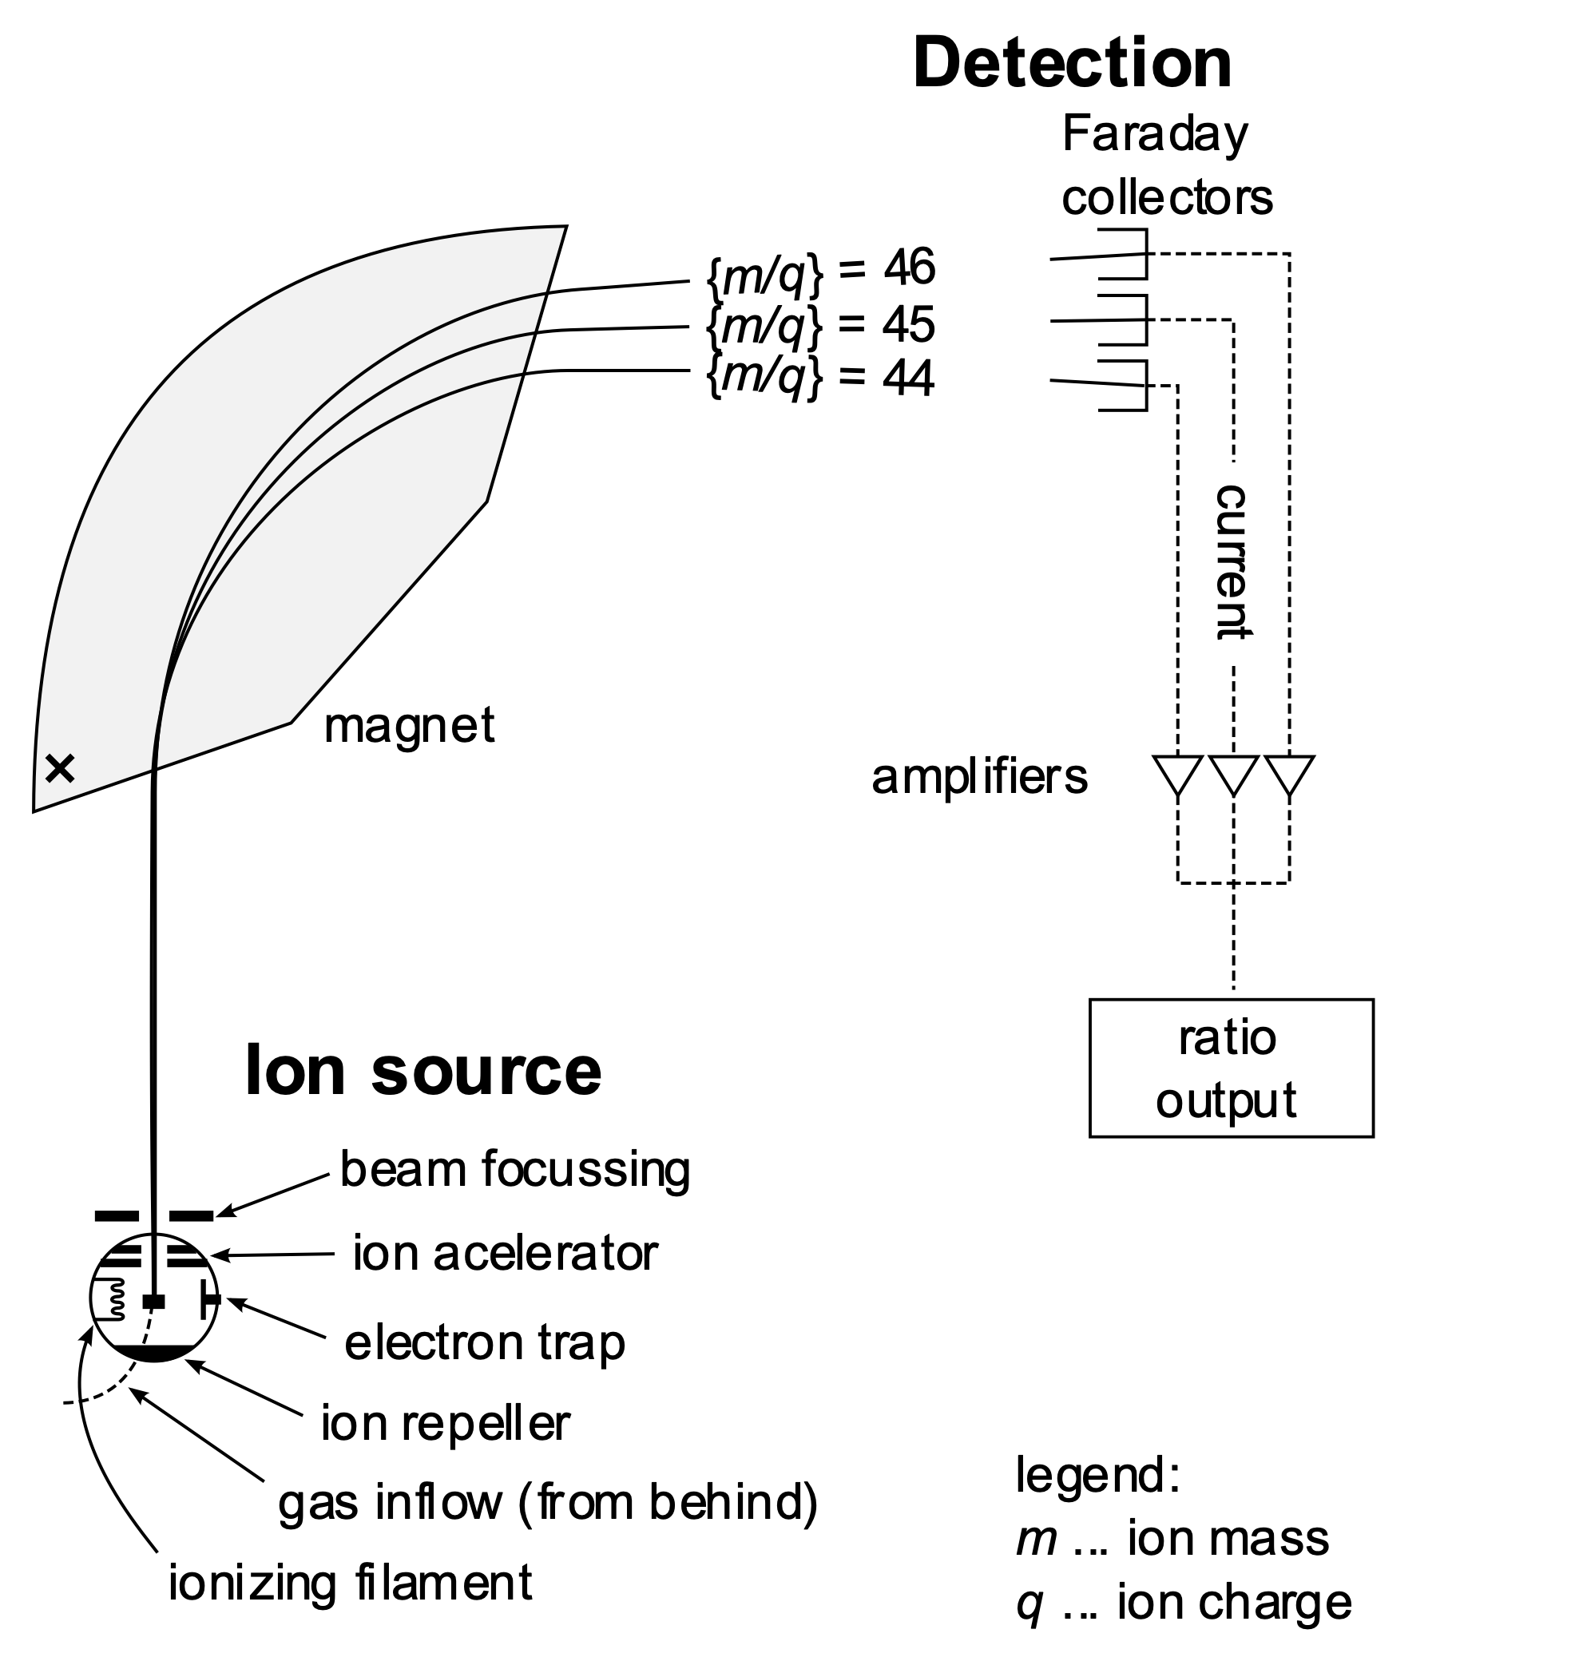
Measurement
Notes:
This is a mass spectrometer. The sample is ionized and accelerated in a vacuum to pass through a strong magnetic field. The ions have different ratios of charge tp mass so swing through different pathways. The ions are collected separately and counted.

Slide 16
Potassium decay
Notes:
The isotope of potassium that is used is a tiny portion of all the potassium and it turns into Argon and Calcium in the ratio shown.

Slide 17
Calculating mass of potassium
Notes:
There is no argon to start as it is a gas –so bubbles out of molten mix.

Slide 18
Time equation for radioactive decay
Notes:
This is just the old equation rearranged

Slide 19
Example of K-Ar dating

Slide 20
Comments on K/Ar decay dating
Assuming a ‘closed’ system
No fracturing of the rock
No argon present at crystallisation
No contamination of sample with argon
Very young rocks will have small amounts of argon – about same as in the air – big error margins

Slide 21
Potassium-argon summary
Superseded by more modern methods
Potassium abundant
Moderately prone to thermal resetting (hornblende has high closure temperature)
Lack of system of checks of validity (Argon-argon measurement better).

Slide 22
Potassium – argon dating II

Slide 23
Laser heating
Notes:
Able to focus laser beam onto individual crystals

Slide 25
Argon - argon step-heating
Notes:
Using step heating (heating up and measuring repeatedly) gives a more accurate estimate of the age

Slide 26
Samarium - neodymium decay

Slide 27
Fractional crystallisation

Slide 28
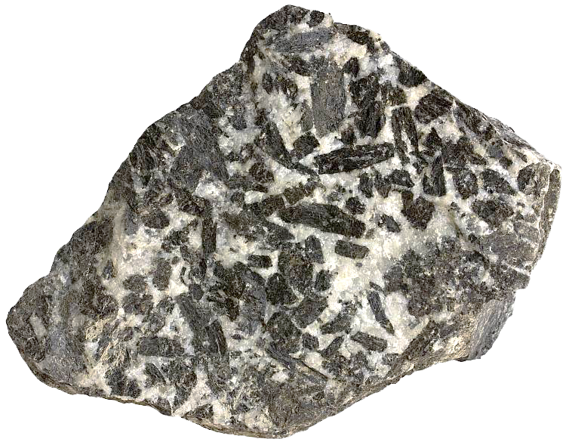
Samarium – Neodymium decay
Gabbro
Notes:
The dotted horizontal trace shows that the ratios of the two Neodymium isotopes is the same in all the different crystals (Isotopes behave the same chemically)
As we start the clock running Samarium is being lost (so the points move left) and Neodymium is being gained(the points move up) The radioactivity law also says that the the points at the right of the graph will decay faster than the points on the left.
The points keep on a straight line that gets steeper as the rock gets older

Slide 29
Sm/Nd decay
Notes:
We can use this with separate minerals and with sample taken at different places on the same rock (less accurate because points closer together)

Slide 30
Sm/Nd
Notes:
Point off the line means an error (or an inclusion in the rock that is older – because it is on a steeper line)

Slide 31
Meteorite isochron
Notes:
Age of a meteorite roughly same as age of solar system

Slide 32
Moon rocks
Notes:
Again compare with solar system age

Slide 33
Isochron with error bars
Notes:
In practice we look at best fit and can estimate accuracy of our result

Slide 34
Samarium-neodymium summary
Resistant to thermal resetting
Long half-life
Most suitable for mafic rocks (better uptake of samarium) – use rubidium-strontium for felsic rocks
Not used for ‘young’ rocks

Slide 35
Sm/Nd example 1

Slide 36
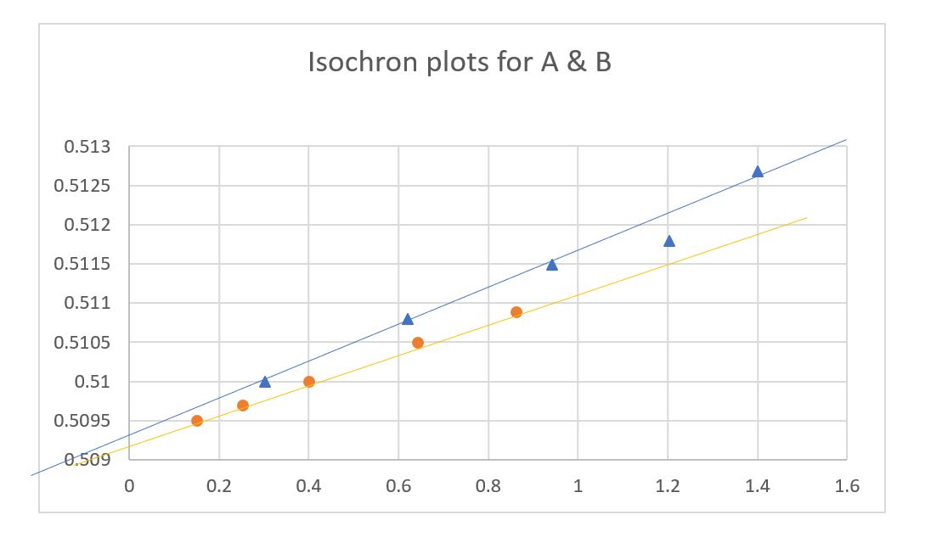
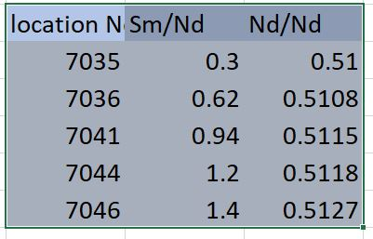
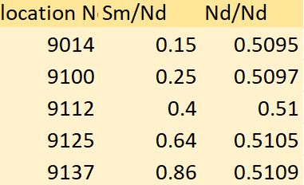
Sample A
The slope of the graph for sample B is shallower than A, so A is older
The data points for sample B are closer together, so B is less reliable
The data from location 7044 (sample .A) is off the isochron, so is wrong for some reason
Sample B

Slide 37
Notes:
Zircon has been in the melt – so indicates a greater age

Slide 38
Notes:
Important to show that carbon dating is useless for geological dating

Slide 39
Resources
Books
Looking into the Earth - Alan Mussett & Aftab Khan (Ch15)
Unlocking the stratigraphic record – Peter Doyle & Matthew Bennett (Ch12)
Web-based
An overview of radiometric dating https://dept.astro.lsa.umich.edu/ugactivities/Labs/GeoAge/GeoAgeIntro.html
Samples of isochron plots www.onafarawayday.com/Radiogenic/CH4/Ch4-1.htm
Live demonstration of doing the calculation for potassium – argon decay www.khanacademy.org/Science/biology/history-of-life-earth/radiometric-dating/v/k-ar-dating-calculation
Automatically working out integrals www.integral-calculator.com

