Slide 1
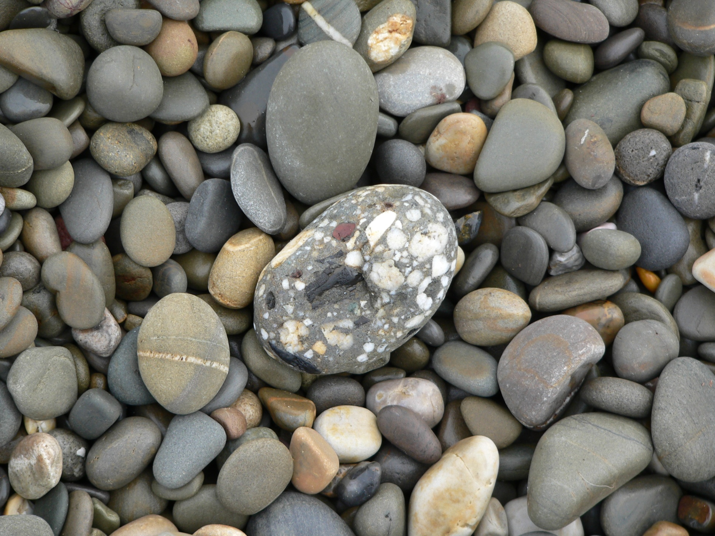
Particle size, shape and sorting:
what grains can tell us
Maggie Williams

Slide 2
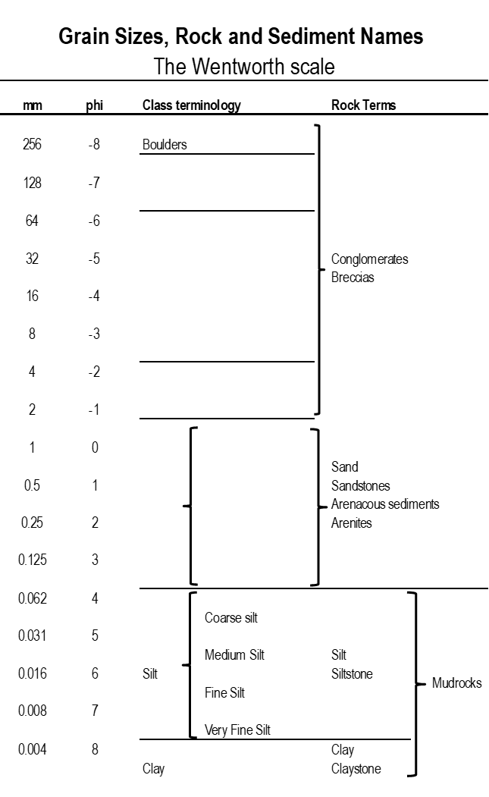
Most sediments contain particles that have a range of sizes, so the mean grain size, which is an average is used in descriptions.
Mean grain size of loose sediments is measured by size analysis using sieves.
The phi scale is a useful, logarithmic-based modification of the Wentworth scale.
n.b. Grain-size diameters in millimetres are converted to phi units using the conversion formula: phi (ϕ) = - log2S, where ϕ is size expressed in phi units and S is the grain size in millimetres.

Slide 3
Grain size
>2mm Coarse grain size (Granules<pebble<cobbles<boulders)
0.06 to 2mm Medium grain size Sand: very coarse-coarse-medium-fine-very fine)
<0.06mm Fine grain size (Clay<silt) Difficult to see
Remember that for sediment sizes greater than fine sand, the coarser the material
the greater the flow velocity needed to erode, transport & deposit the grains

Slide 4
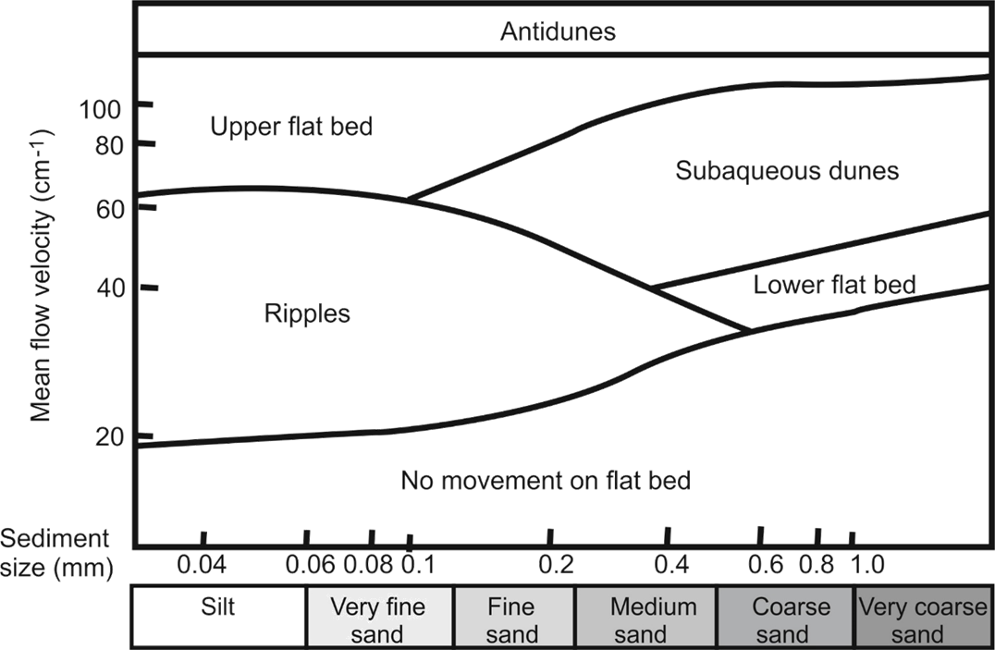
Bedform phase diagram for unidirectional flow
This shows the relationship between grain size and flow rate and to classify the sedimentary structures formed.
3D
2D
3D
2D
2D straight 3D linguoid (ripples)
lunate (dunes)

Slide 5
Are the grains the same size of different?
What does this tell you?
If grains are the same size this tells you that the sediment was sorted out
during longer transportation (perhaps moved a long distance by a river or for a
long time by the sea.
If grains are of different sizes the sediment was probably deposited close to its
source or deposited quickly (e.g. by a flood or from meltwater).

Slide 6
Depositional environments

Slide 7
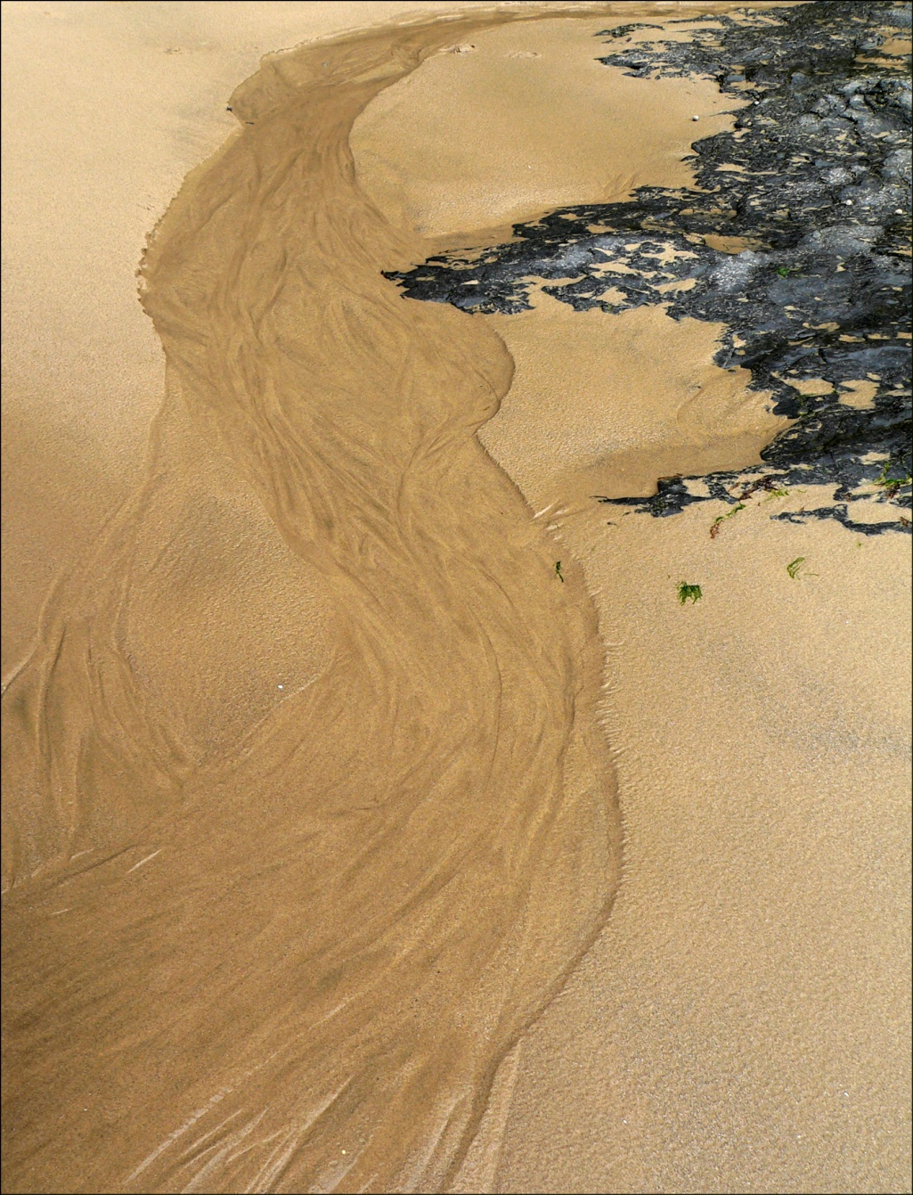
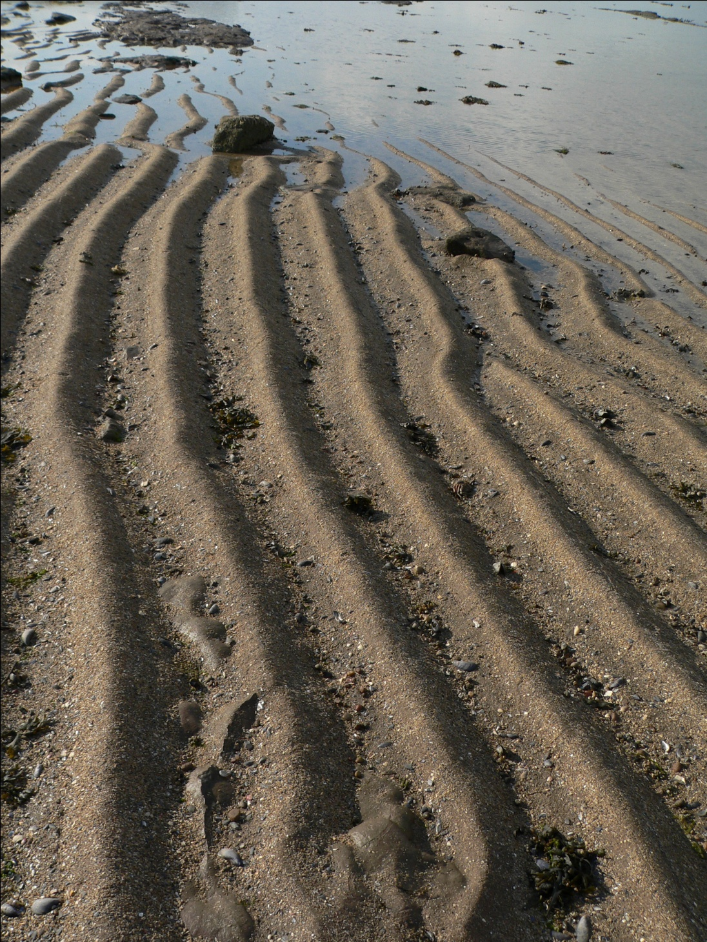
Environment 1

Slide 8
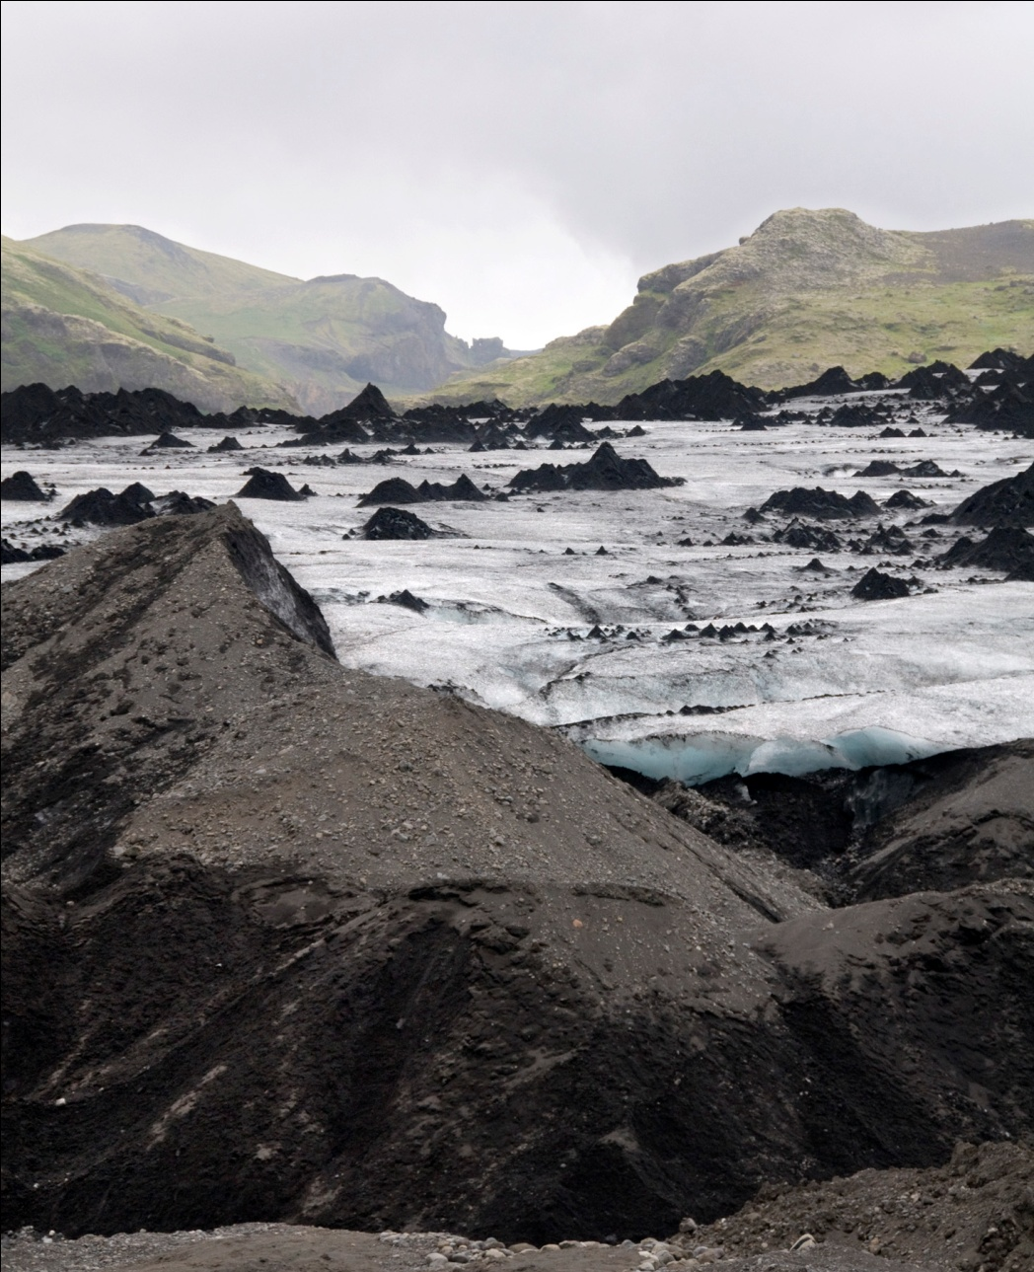
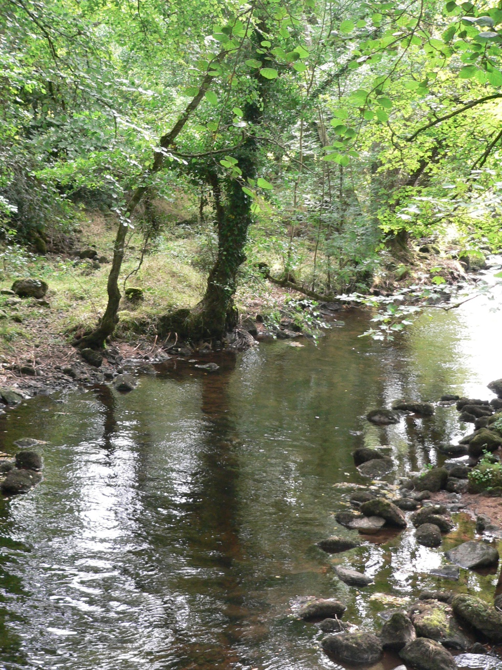
Environment 2
Environment 3

Slide 9
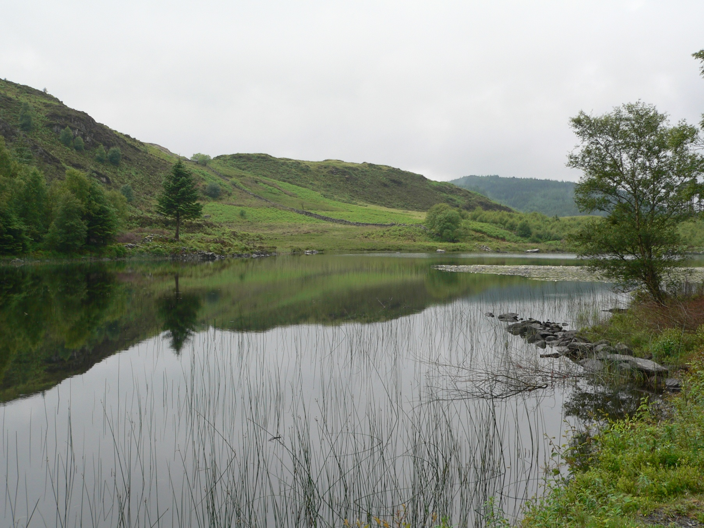
Environment 4

Slide 10
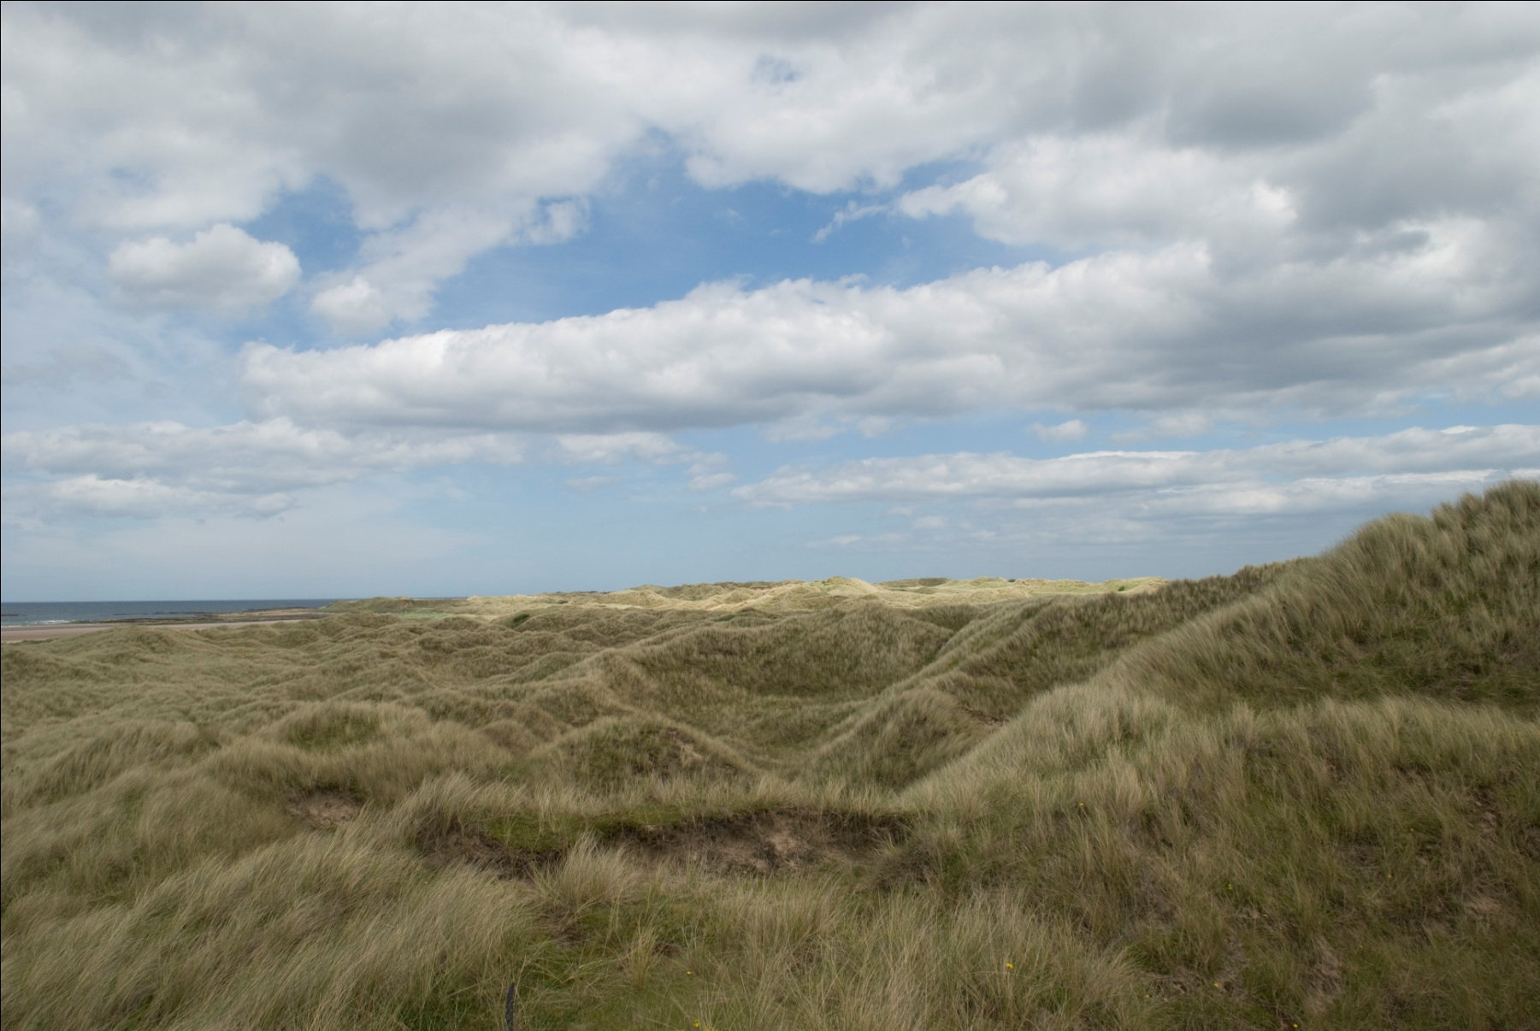
Environment 5

Slide 11
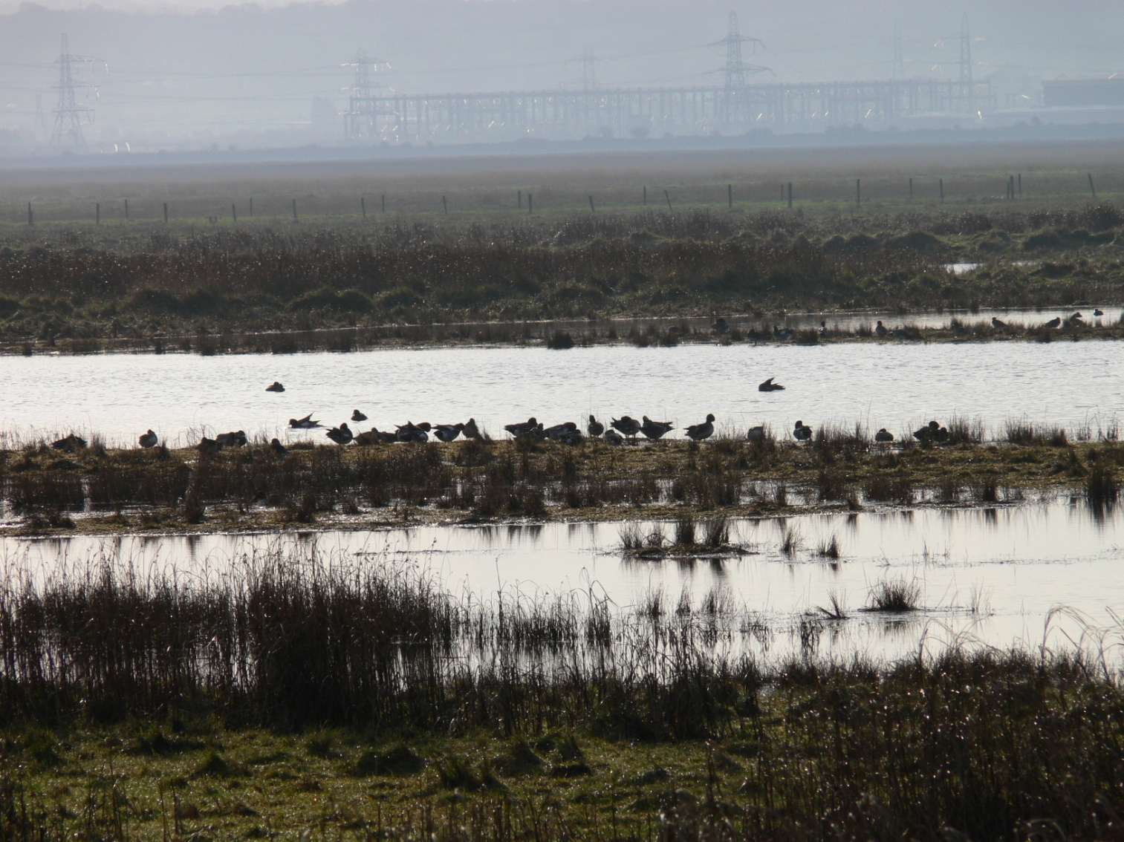
Environment 6

Slide 12
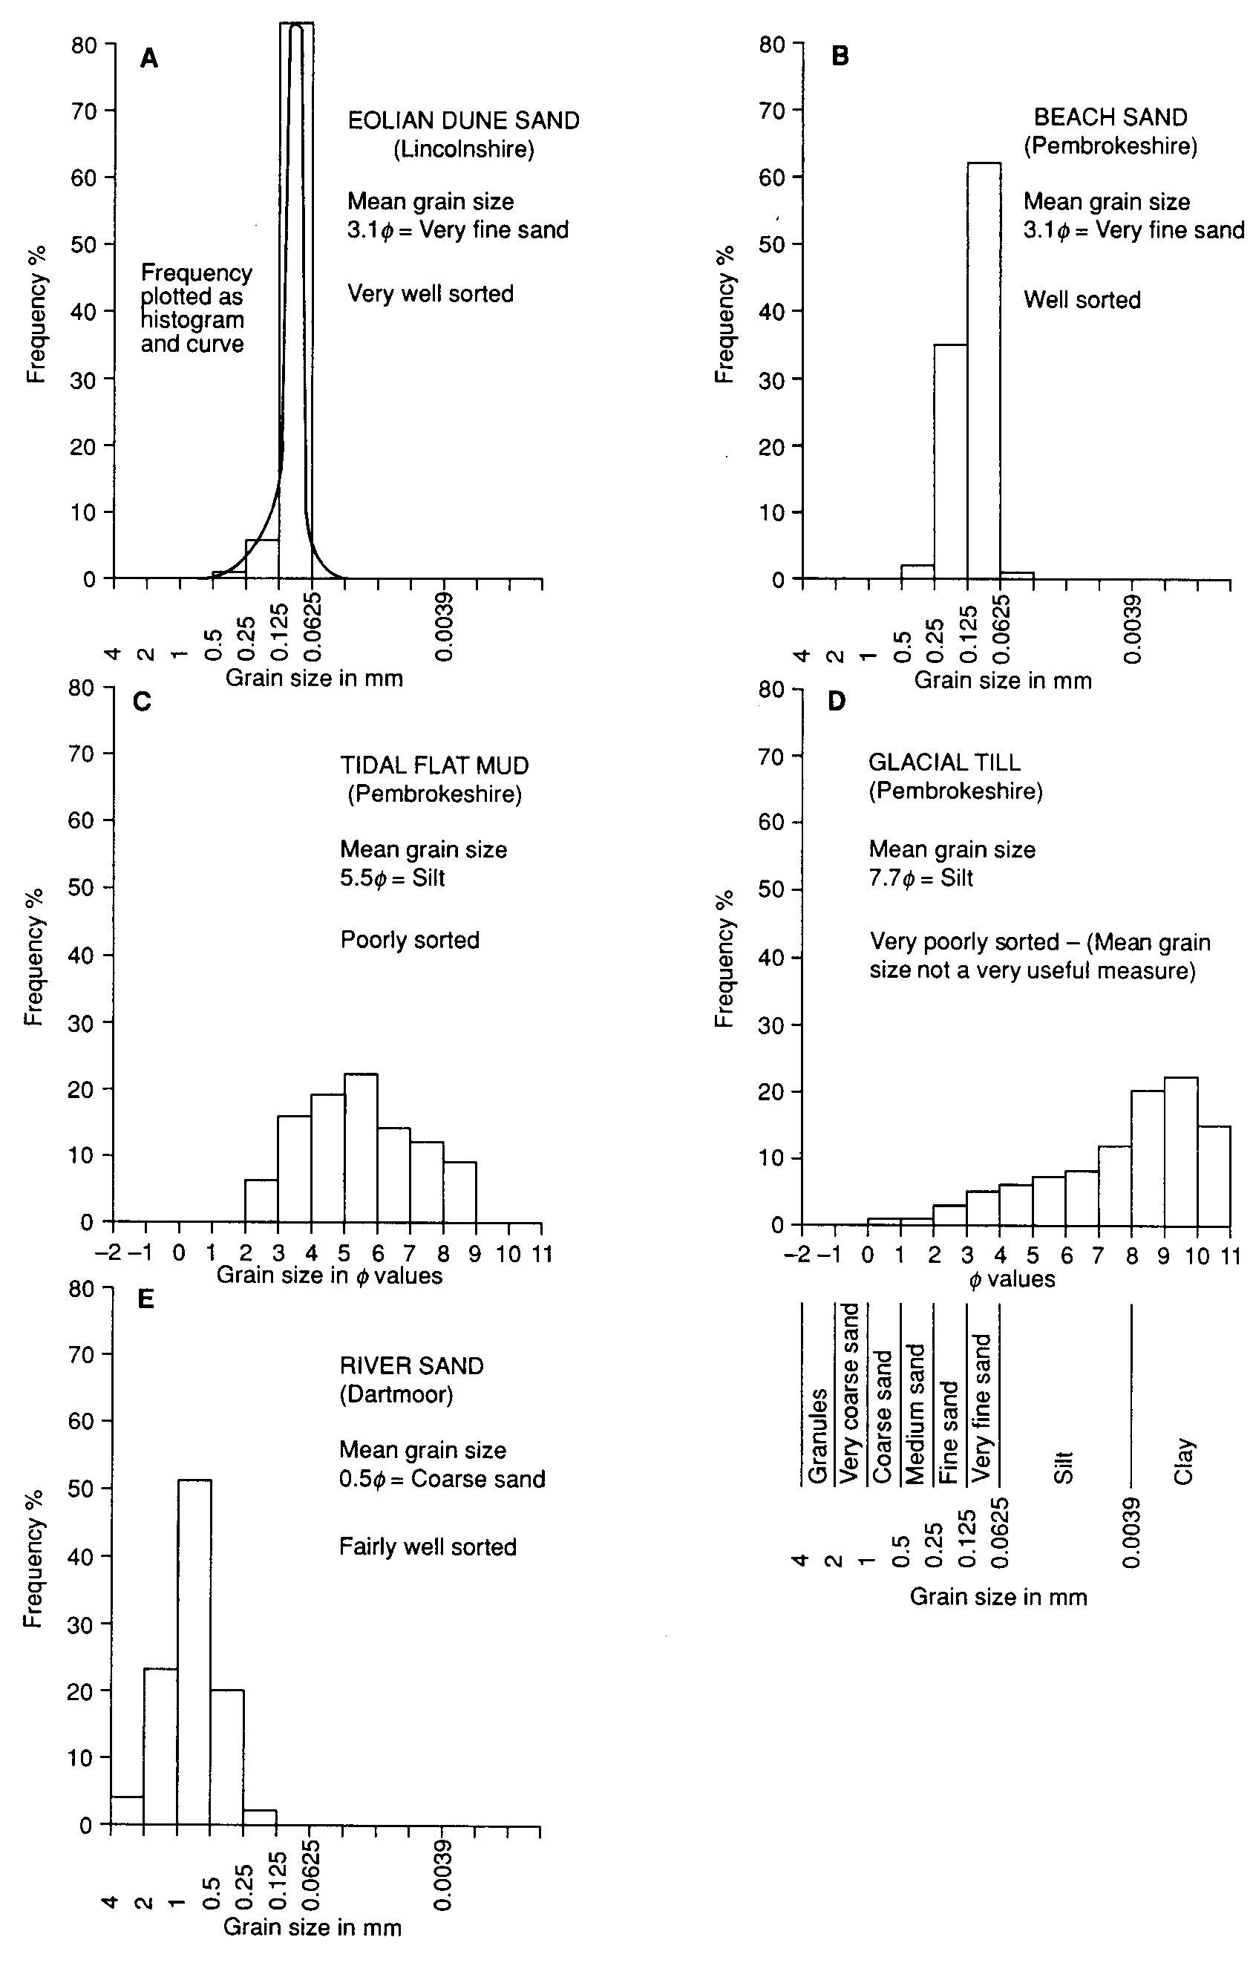
Sediment size frequency plots
from different depositional
environments

Slide 13
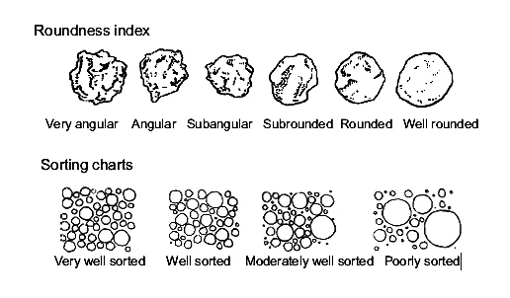
Grain sorting
What is sorting?
Very well-sorted sediments - grains all the same size
Very poorly-sorted sediments - grains with a wide range of sizes
What does sorting tell you?
Generally, sediment sorting improves along the sediment transport path.
Poorly sorted sediments were usually deposited quickly (e.g. in storm beds
or from flows/mudflows. Better sorted sediments may have been reworked by
wind or water. (e.g. Sand deposits on beaches, in shallow seas or in deserts)

Slide 14
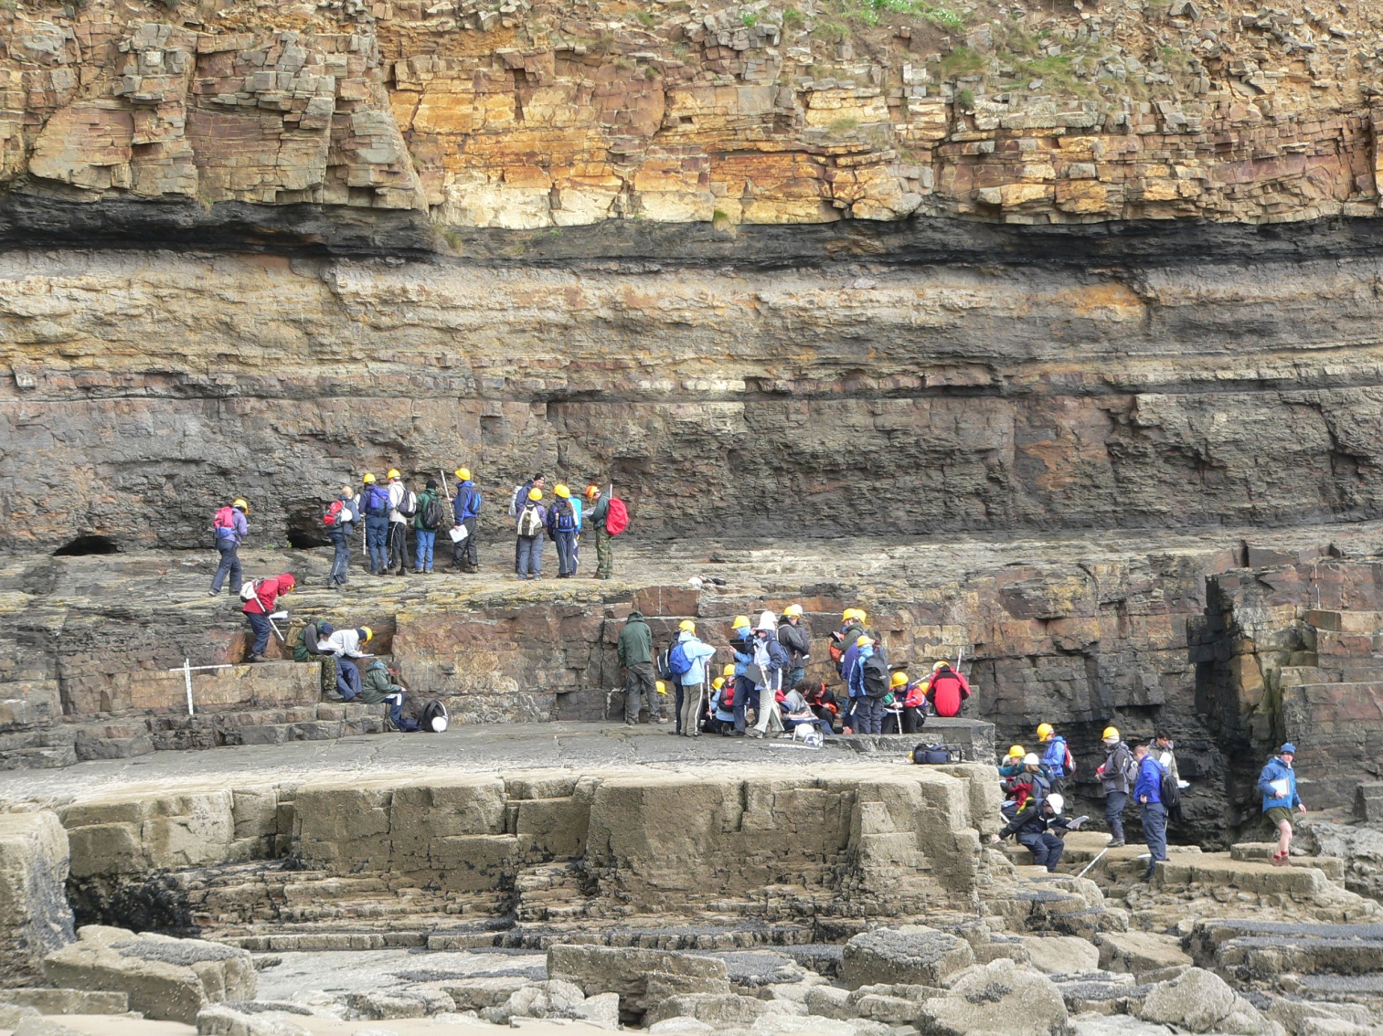
Studying sedimentary rocks

Slide 15
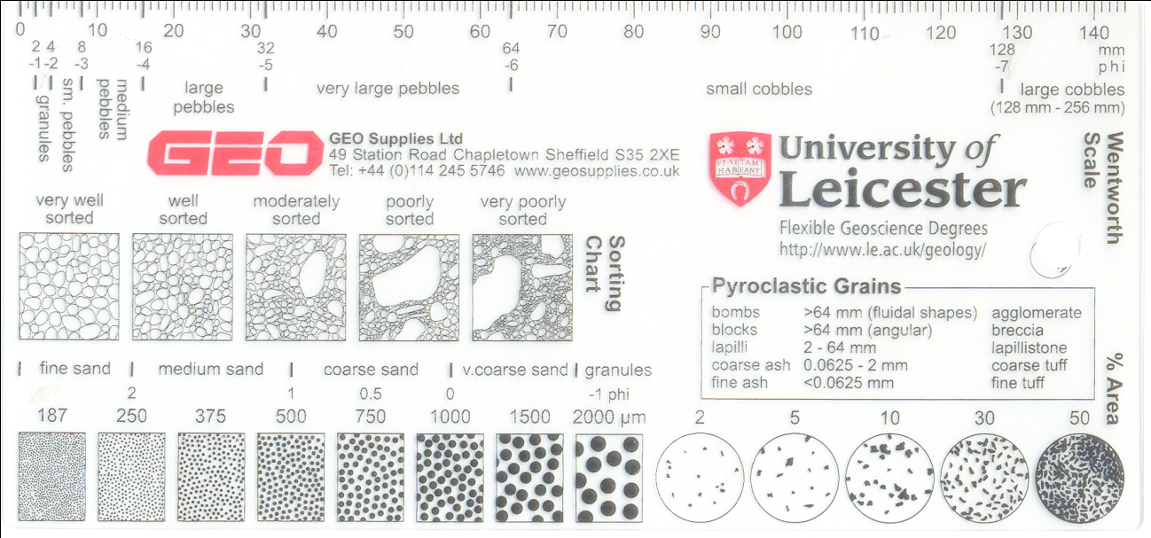
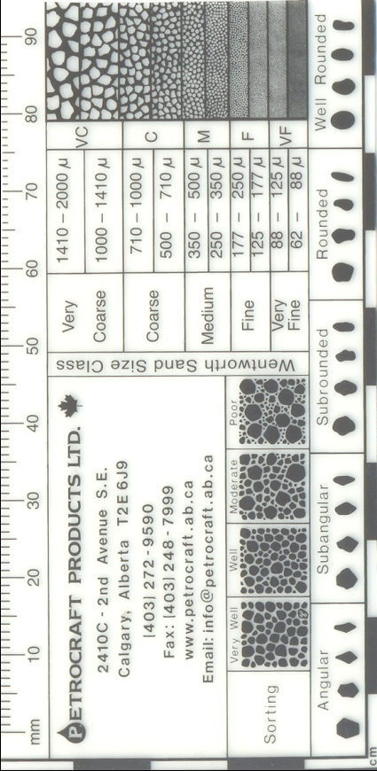
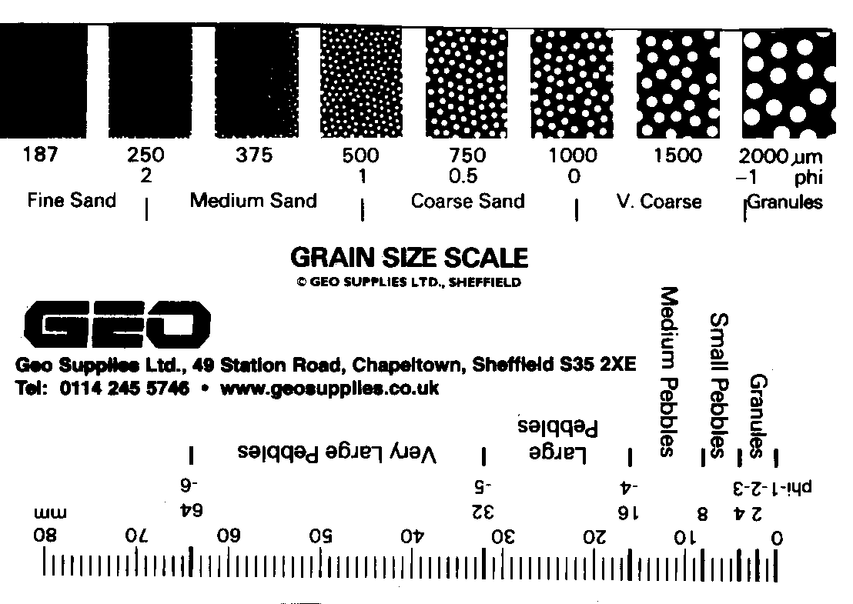
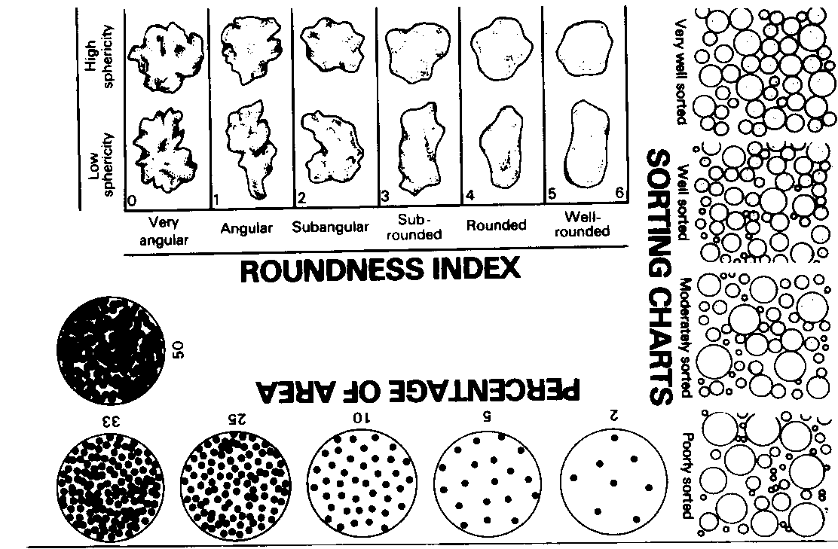
Mean grain size and sorting - more difficult to analyse in consolidated sedimentary rocks

Slide 16
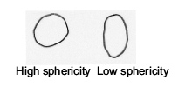
Grain shape
What does high or low sphericity tell you?
Not much! Sphericity of grains mainly depends on the physical properties of
the source material. (Sphericity is little changed by transport)
What does the degree of rounding tell you?
Generally – the more rounded the grains are the more they have been moved
around (i.e. the longer the length of time or distance they have moved).
Angular grains cannot have travelled far.

